Slide 1
Pokemon Emerald:
Gold Trainer Card &
Complete National Dex
Guide
Created by BananaBoatKid

Slide 2
Rules
Read everything and look at each image carefully. I promise I don’t waste your time in this guide.
No cheating devices. Original Hardware only for ALL games.
RNG manipulation is used for excellent I.V. pokemon (mainly used for Battle Frontier without glitches). Stable ACE can be used for completion of the battle frontier as well with max stats glitches. But I wanted to include a legit way to beat in this guide anyways just in case.
Legitimate, non harmful, vanilla glitches are used in post game (ex: item duplication, pomeg berry glitch, Stable ACE etc…).
Trading is necessary for legitimate pokedex completion, so ALL generation 3 games can be used including Colosseum and XD.
Pomeg Berry glitch/ Stable ACE can be used for mythical pokemon such as Jirachi, Deoxys, Mew, Celebi
Event cartridges can also be used for event only pokemon. I do own one myself.

Slide 3
Requirements
Pokemon Sapphire, Ruby, Emerald, FireRed, Leafgreen, Colosseum, XD
2 GBA systems, link cable/2 wireless adapters, Gamecube, Gamecube-GBA link cable, *Event Cartridges/E-Readers for events (optional)
Pokefinder software - (should download automatically upon clicking. Extract all to desktop). (technically optional) https://github.com/Admiral-Fish/PokeFinder/releases/download/v4.1.2/PokeFinder-win.zip
Flow Timer software - (should download automatically upon clicking. Extract all to desktop). https://gunnermaniac.com/ft (technically optional)
Both of these are used for RNG manipulation

Slide 4
Getting Started
Start a new save on Pokemon Sapphire or Ruby.
Choose a starter that you will NOT choose in Emerald. Play through the games normally at least until you get the Masterball from the team hideout in Lilycove City. Do not use the masterballs.
I highly recommend collecting all available evolution stones including the ones traded for colored shards. Get the deep sea/tooth scale from Captain Stern.
Catch all version exclusive pokemon on the way, including immediately available legendaries.
Optional - catch the rare counterparts in each version for Emerald (ex: plusle is common in sapphire while plusle is very rare in emerald and ruby.)
Do this same thing on the other version you did not choose.
Make sure to choose the starter you did NOT choose for both your starting version and plan to for Emerald.
Collect all the opposite “choice items” just to be on the safe side. (ex: deep sea scale/tooth, fossil, etc)
Hold on to these save files for later. Ruby and Sapphire are done for now.
All items will get traded to Emerald for some extra help. Do not use any stones, Master Balls, TMs, Berries or Items that you want more of.
*Also I suppose you may as well also just do this for FireRed and LeafGreen.*
*See next slide for version exclusive pokemon*

Slide 5
Ruby, Sapphire Version exclusives and counterparts
Exclusives/Counterparts
* indicates not available in Emerald, but found in BOTH Ruby and Sapphire
Ruby: Seedot family (1% on Emerald), Mawile (5% on Emerald- Victory Road Dark Areas), Zangoose, Solrock, Groudon, Latios.
Sapphire: Lotad family (20% on Emerald), Sableye, Seviper, Lunatone, Kyogre, Latias.
Surskit* is in BOTH Ruby and Sapphire, but NOT Emerald. Catch this on either game.
In Short, Trade all these to Pokemon Emerald
Ruby - Seedot, Mawile, Zangoose, Roselia*, Meditite*, Surskit*
Sapphire: Plusle, Volbeat, Roselia*, Grimer, Lunatone, Meditite*, Surskit*
All of these pokemon are either rare or unobtainable in Emerald. Not worth looking for when you can just trade them easily. Put the Masterballs, and any items you want to trade over on any of these Pokemon and keep them ready for trading to Emerald. Additionally, get the evolution stones, and Clamperl with evolution items ready.

Slide 6
Manip info and “rules”.
If you are manipping static pokemon please refer to this slide on each one.
Rule 1: Save. Save even prior to when you think you need to, THEN figure out where you need to precisely save.
Rule 2: Always have an empty slot in your party so you can easily check the stats of your pokemon on each attempt.
Rule 3: FlowTimer times will vary for everyone. SP, GBA, Gameboy Player, DS, and any other platform will all have different input lag and button stiffness and all that kind of stuff. Do not get discouraged if the times I have aren’t really that close to what you end up needing to set YOUR timer for. The key is finding your pokemon in pokefinder and adjusting your timer based on your needs. Sorry that was a long rule.
Rule 4: Outside of the starter manip, Use Master Balls to capture manipped pokemon. Duplicate them in the post game. Trade them from another game. Do not do each attempt with ultra balls or something stupid. It already takes long enough to wait for the timers.
Rule 5: In order to see which pokemon you received in game, you have to match the STATS not the IVs in pokefinder. The game doesn’t show IVs anywhere. Check the “Show Stats” box in pokefinder to see that stats for your pokemon.
Pokemon guide
Groudon and Kyogre: These are the only 2 manips that don’t start by talking to the pokemon. Instead, save ONE space away from them in their respective caves. Save prior to that even so you can practice and see for yourself first when they engage you. Press right/left on the d-pad to walk in front of them when the last beep happens on your flow timer.
For Beldum, press A on “YES” on the last beep when it asks you yes or no to take the pokemon.
All others, you just press A on the pokemon

Slide 7
Starting Emerald
Requirements to start playthrough (see slide 3 for downloads)
Flow Timer
Pokefinder
We will be manipulating an excellent Mudkip starter through the use of flow timer and pokefinder.
This isn’t REQUIRED, but it’s highly recommended. Not only will the entire game just be easier, but it will make the Battle Frontier much more bearable. It’s very easy to do this. if you don’t want to manip the pokemon and use other methods of completing the battle frontier, skip manipping slides.
Pokefinder is used for finding which Mudkip, or any static pokemon you received so you can adjust your flow timer accordingly, nothing more.
Upon opening flow timer, you will notice Mudkip is already a default choice. It’s done for you. Unfortunately, everyone's average reaction time is different. Ideally, the Mudkip that is defaulted in flow timer is 17.116 seconds into the game upon soft resetting. (explained more later).

Slide 8
Disclaimer
Manipping pokemon is not required. I wanted to include it in case anyone wants to try to beat the battle frontier legitimately without glitches. The pokemon that are used for this guide for battle frontier are very good and will give you a nice chance to beat it if you never have before.
If you decide to use Stable ACE (Arbitrary Code Execution {in game glitches}), manipping doesn’t matter. Play the game exactly how you want and ignore all of the static encounter manipping slides. Keep in mind, this guide is based off using mudkip, so if you choose something else, your rival will have a different team.
Manipping is honestly quite easy to do though if you want to try it. Just read very carefully.
Whatever you decide, make sure you still set your clock in your room to 3pm or 3am!!

Slide 9
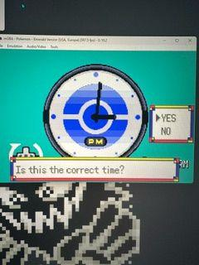
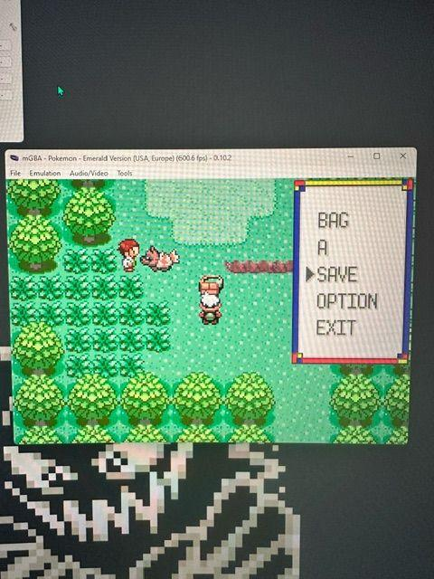
Starting Emerald
Boot up the game as normal. Start new game, choose your gender and name.
Walk out of the truck and your mom will tell you to go to your room and fix your clock.
VERY IMPORTANT - if your internal clock has run dry, you MUST set your clock to 3 PM or 3 AM to have Low Tide in Shoal Cave for Snorunt.
Get potion out of PC storage in room
Go to rival’s house, go upstairs and press A on pokeball.
Go back outside and go North towards the first route.
Save your game right at Professor Birch’s bag. Do not select a pokemon.
Turn your game off.
If you are not manipping, you don’t need to turn off your game. Just continue.

Slide 10
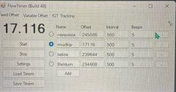
Mudkip Manip
Open Flow Timer. It might not let you open it at first but click on “more info” and “run anyway” if you get the screen for it.
This is what you should see. I have some other timers saved, but the Mudkip one should already be on there.
If not, click add, set name to Mudkip, type 17116 in offset, 500 interval, 5 beeps.
Make sure Mudkip is selected.
*you need to make it so you are able to press “A, B, START, SELECT” on your system to soft reset AND
start the timer at the same time. So go into the settings on flow timer and
set a hotkey that works for you to start the timer with.

Slide 11
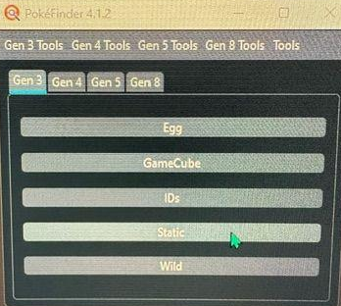
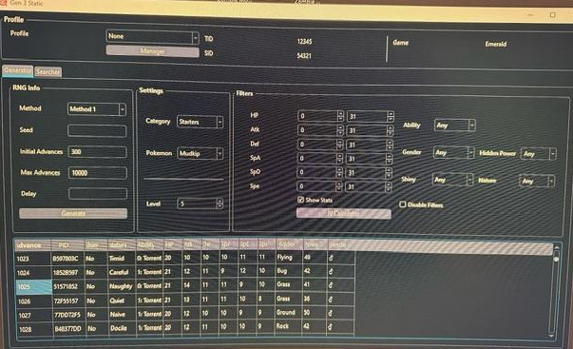
Mudkip Manip
Open Pokefinder. Make sure the Gen 3 tab is selected, then select STATIC. This will bring up a new window.
The new window should look like this.
Category - Starters
Pokemon - Mudkip
Method - Method 1
Check ‘Show Stats’ Box
Click Generate
Set your initial advances to around 800 and max advances to around 1200
The correct Mudkip is highlighted in the image. Frame 1025.
Correct stats are 21 HP, 14 ATK, 11 DEF, 11 SpA, 9 SpD, 10 SPE
Naughty Nature, Hidden Power Grass, Male gender

Slide 12
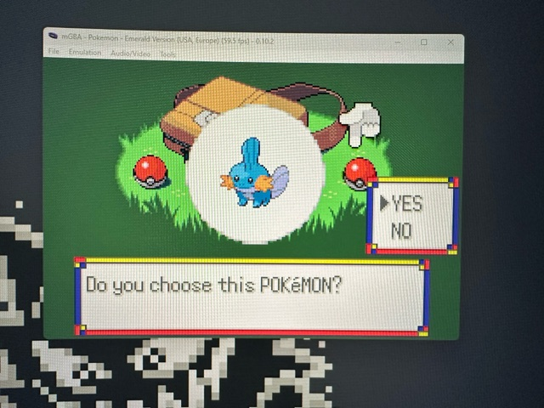
Mudkip Manip
Now that we can see the available Mudkips and their associated frames, start your Emerald back up and just wait at the bag. Don’t press anything yet.
With the Flow Timer selected as your top window, sound on, and the Mudkip timer selected…
Simultaneously start the Timer and soft reset the game using A+B+START+SELECT.
Then mash A through all the intro cutscenes and start your game. Press A on the bag and scroll over to the Mudkip pokeball and press A to get to this screen here.
The goal is the press A on YES option right on the last beep of the timer. (5th beep).

Slide 13
Mudkip Manip
Take a look at your Mudkip’s summary on each attempt. Look at the stats and find which Mudkip you have on Pokefinder. (Make sure the ‘stats’ box is checked in pokefinder). You can also use the filters such as Nature select to find your Mudkip more easily in pokefinder. Once you have found your Mudkip in pokefinder, look at it’s frame number and adjust your flow timer accordingly to how late or early you were compared to the target Mudkip on Frame 1025.
Remember the game runs at 60 fps. Flow Timer seems to use 59.7275 frames however.
If you got, for example the Frame 1035 Mudkip, you would adjust your timer by doing 1035-1025 which is 10 frames. (late in this case).
Take this 10 frames and divide it by 59.7275 frames per second and you get the amount of seconds you need adjust your flow timer by.
In this example 10/59.7275 is 0.167. So now you would Subtract 0.167 seconds off of your current timer time and then try the manip again. Keep adjusting until you are very close to the correct Mudkip frame and from there it’s really just luck.
If you hit a Mudkip frame that was early, you would of course ADD the time to your Flow Timer instead.

Slide 14
Full Emerald Adventure
Some things to note first….
This will be a full and in depth guide on everything there is to know about Pokemon Emerald.
All routes, towns, wild pokemon, hidden items and important NPCs will be highlighted on each slide.
One slide will typically = 1 route/town. It will be noted if more than one slide is used.
CAUTION: I highly recommend using as little items as possible throughout the adventure. Here is a list of items you should always keep AT LEAST 1 of so you can duplicate them later. This is why you want to send some items from your Sapphire/Ruby playthrough such as Master Balls because you will need them before you can duplicate.
All TMs that are not buyable, Rare Candy, PP MAX, Heart Scale, Masterball, All Evolution Stones (Regular Evolution stones can be traded via FireRed/LeafGreen easily if need be), Max Elixir, Max Revive, Pomeg Berry (don’t use ANY Pomegs during playthrough), Lum Berry, (honestly just all berries), All hold items, anything else you deem important.
TIP: Technically if you really wanted to use a starter that wasn’t Mudkip, you could just trade the manipulated one to another game ASAP and start a new adventure on Emerald with the starter you want for your normal playthrough. That way you can also EV train the Mudkip properly later and trade it back. You have to get this Mudkip though at least once. He will help you greatly in the hardest part of everything in this guide which is the Battle Frontier. He works just fine for Battle Frontier though if you use him normally without EV training throughout the main adventure...so your call on that.

Slide 15
Rival fight route 103
Your rival’s team changes depending on what starter you choose; and it's not just their starter. Throughout this entire powerpoint, all rival battles show the team they would have if you chose Mudkip. If you traded your Manipulated Mudkip to a different game and started Emerald again with a different starter, the teams you will see for them will not be correct. Sorry, I only had room for Mudkip starter rival team info.
After getting your starter, leave Birch’s Lab and go straight North to rival on Route 103 past Oldale Town.
Fight a couple pokemon if you want on the way. I won’t put route information yet since we can’t catch any pokemon.
Just mash your damaging attack and use potion if necessary.
After you beat your rival, go back to Birch’s Lab to receive pokeballs and pokedex.

Slide 16
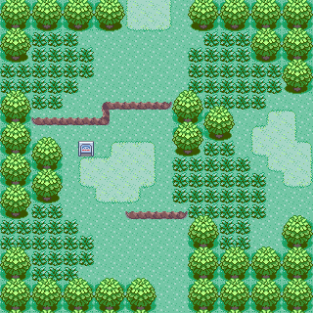
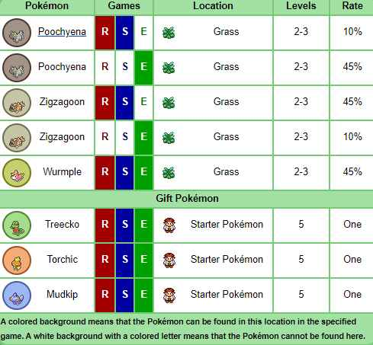
Route 101
No notable NPCs or items

Slide 17
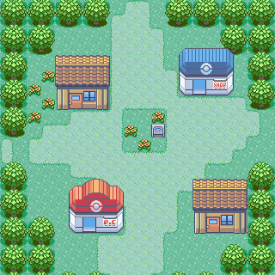
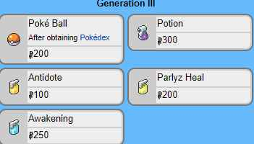
Oldale Town
Route 103
Talk to the shop keeper by the southeast house and he will give you a Potion.
Route 102
PokeMart Items
Route 101

Slide 18
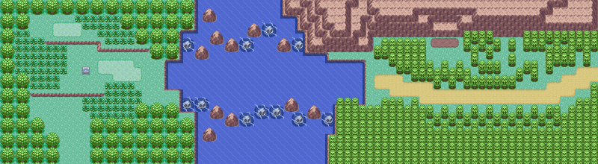
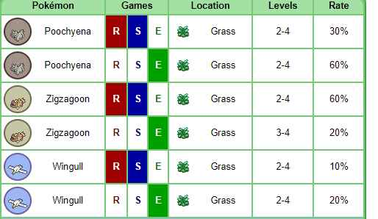
Route 103
Oldale Town
No notable NPCs or items
Cannot access eastern part until surf is acquired. It is a shortcut to Slateport/Mauville.
Once surf is acquired, there will be route information regarding the water/east side.

Slide 19
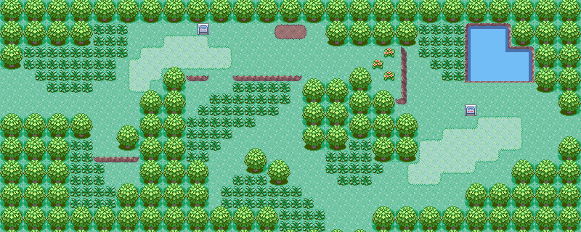
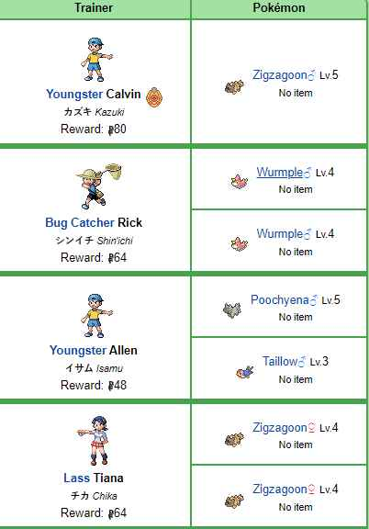
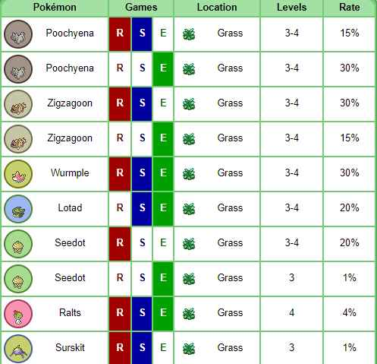
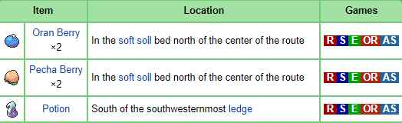
Route 102
Petalburg City
Oldale Town
Potion
No notable NPCs, just trainers.

Slide 20
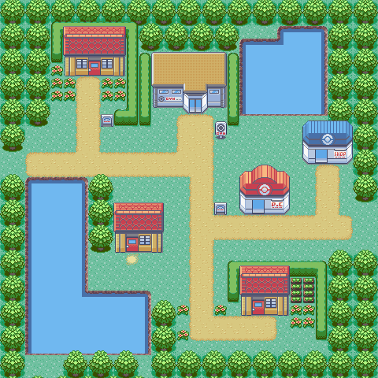
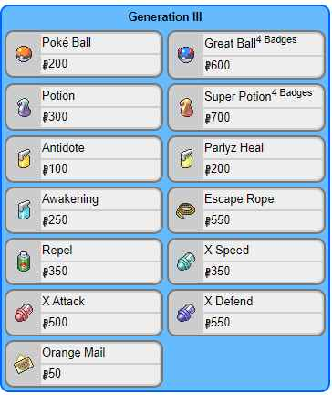
Petalburg City
PokeMart Items
Route 104
Route 102
No notable NPCs, or items (yet).
Nothing to do here for now until Surf is acquired. Go to the gym and continue story with Dad and Wally. Then go West to route 104.

Slide 21
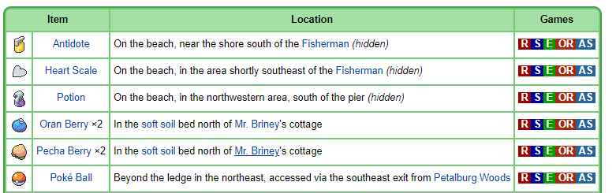
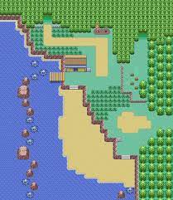
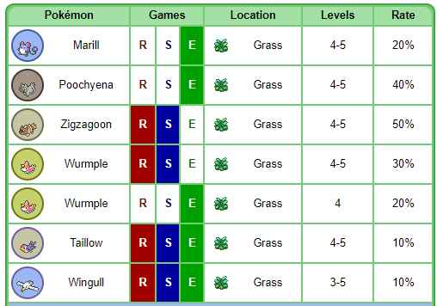
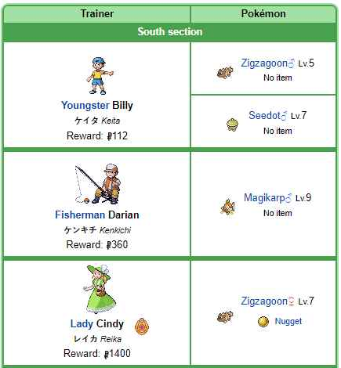
Route 104 (South)
Petalburg Woods
Briney’s Cottage
Petalburg Woods
Southeast Exit
Potion
Pokeball
Heart Scale
Petalburg City
Antidote
No Notable NPCs, just trainers.
Pokeball is obtainable upon entering Petalburg Woods, then exiting from Southeast.

Slide 22
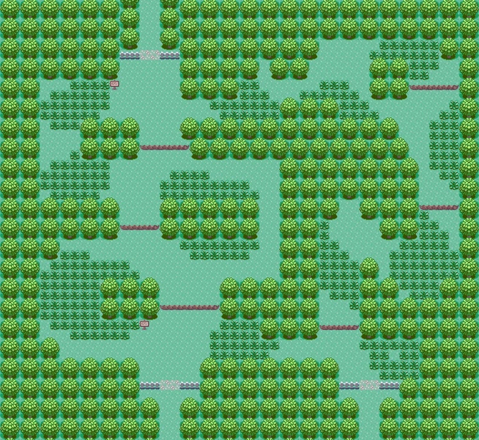
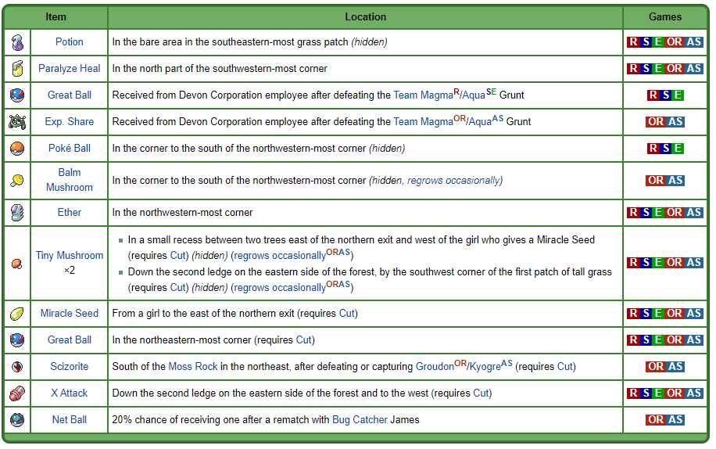
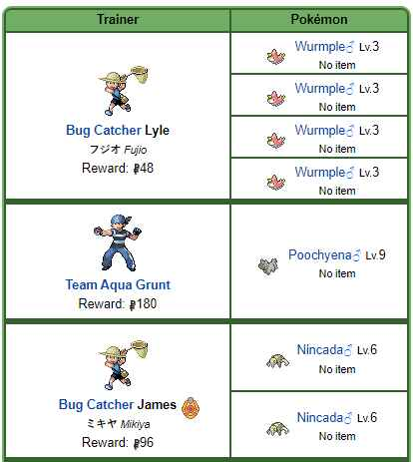
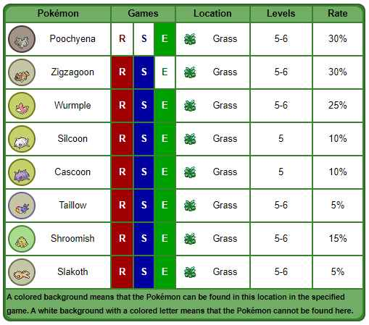
Petalburg Woods
Ether
Route 104
(North)
Pokeball
Paralyze
Heal
Potion
Route 104
Route 104
Southeast Exit
No Notable NPCs (yet). Will revisit with cut shortly. Fight Team Aqua Grunt to continue story.
Greatball is received from Devon Corp guy.

Slide 23
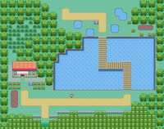
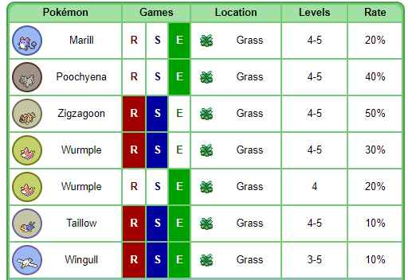
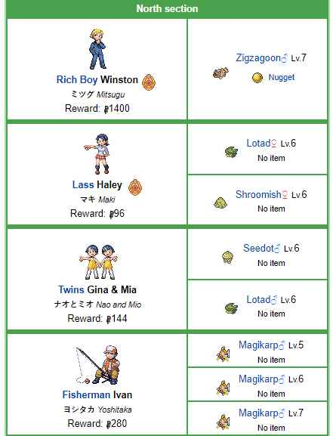
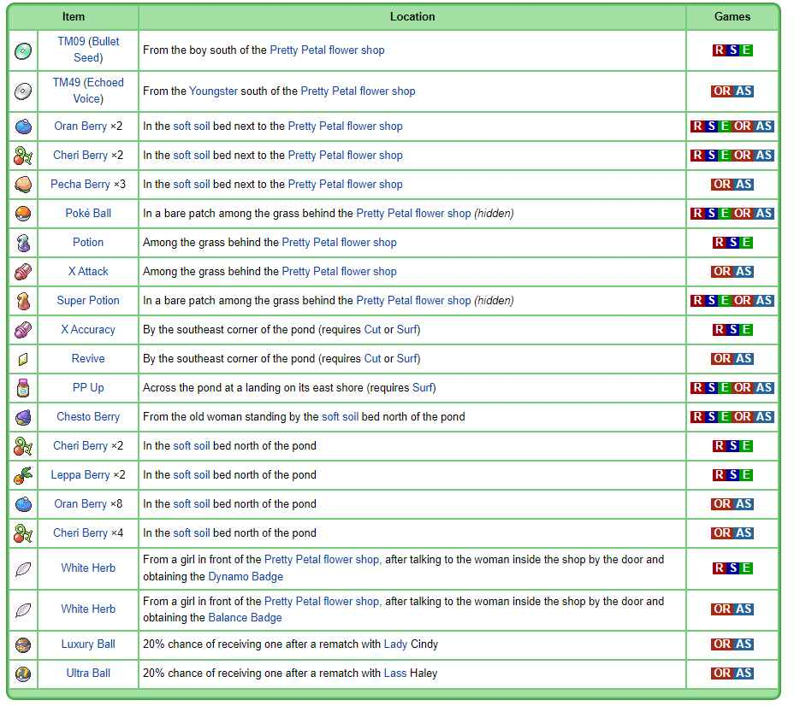
Route 104 (North)
Rustboro City
Super Potion
Potion
Chesto Berry
Pokeball
Pretty Petal
Flower Shop
X Accuracy
Boy: TM09
Bullet Seed
Petalburg Woods
NPCs
Boy South of Flower Shop (Bullet Seed)
All 3 girls inside Flower Shop
Wailmer Pail, Random Berry Each Day
Old Women in Northeast Corner by berries (Chesto Berry)
Cut and Surf will be used later for other items
White Herb after Dynamo Badge (3)

Slide 24
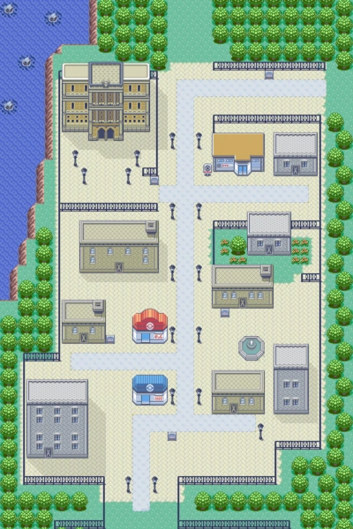
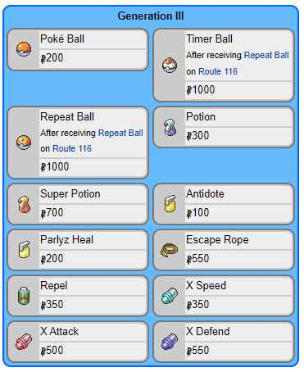
Rustboro City
Route 115
All important NPCs and buildings are noted in picture.
HM01 cut is used on the next route. I highly recommend completing the gym before proceeding unless you need extra training.
Do not trade ralts for seedot this is super important for later
Route 116
PokeMart Items
In-Game Trade
Ralts for Seedot
Professor
Quick Claw
Man at table
HM01 CUT
2F little boy
Premier Ball
Route 104 (North)
X Defend

Slide 25
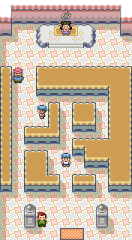
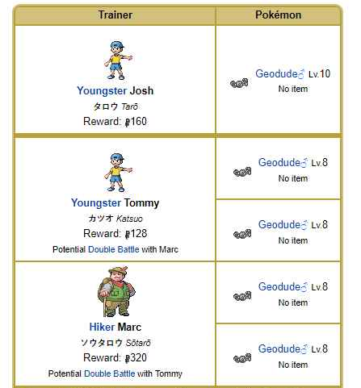
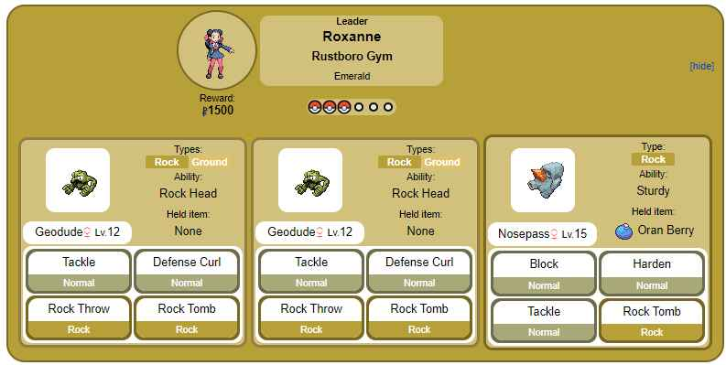
Rustboro Gym

Slide 26
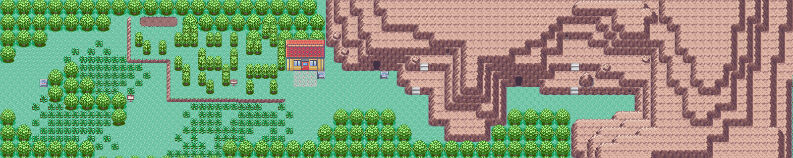
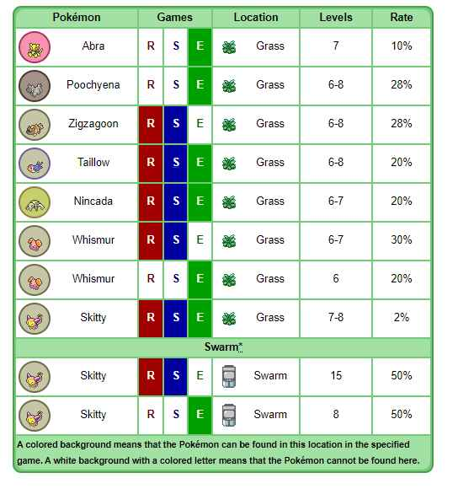
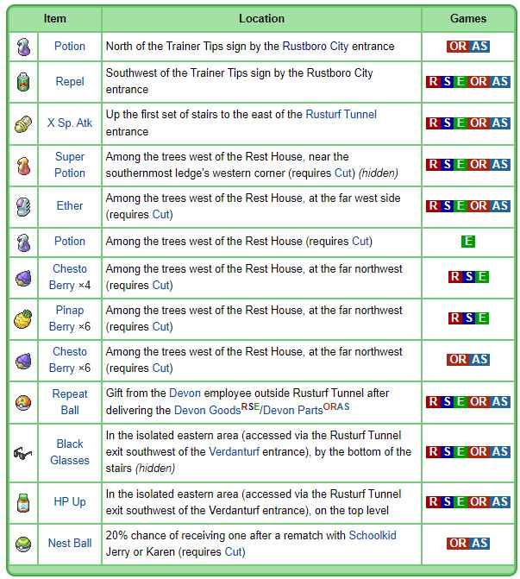
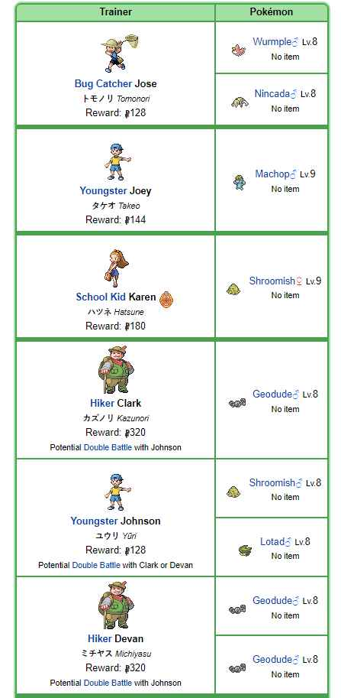
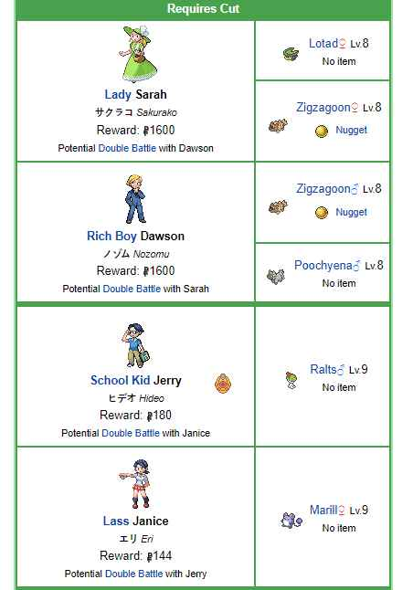
Route 116
Ether
After the cutscene exiting Rustboro gym, go north on to Route 115 for a Super Potion on the most northern part of the beach before going to Route 116. Route 115 will be covered later.
Potion
Super
Potion
X Special
Repel

Slide 27
Rusturf Tunnel
Not much to say here. Get the pokeball. Beat the Aqua Grunt.
Whismur is 100% encounter rate in Rusturf Tunnel.
After beating Aqua Grunt go back to Rustboro and start the Devon President Cutscene.
Once the “cutscene” ends leave the building, call the president, leave Rustboro to the south towards route 104 North. There’s an optional rival fight upon leaving Rustboro.
Use Cut on the tree on Route 104 in the Southeast corner to get the X Accuracy
Enter Petalburg Woods

Slide 28
Petalburg Woods (With Cut)
Girl:
Miracle Seed
Route 104
(North)
Great Ball
Tiny Mushroom
Use cut on the trees to the southeast. Get all the items. Talk to the girl for Miracle seed. Exit Petalburg Woods to the South and go to Mr. Briney’s Cottage. Talk to him. Set sail for Dewford Town.
X Attack
Tiny
Mushroom
Route 104 (South)
Route 104 (South)

Slide 29
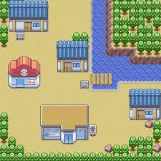
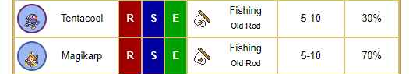
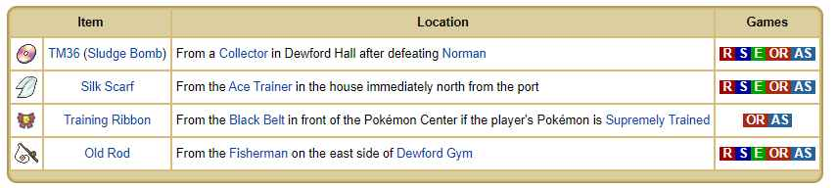
Dewford Town
Route 106
Get old rod from the fisherman and
silk scarf from the house next to the dock.
The gym leader can be fought now OR after
Delivering the letter to Steven in Granite Cave.
TM36 cannot be obtained yet.
Tip: Technically, the gym can be skipped altogether if you deliver the letter and go straight to Slateport. If you want an easy time in the gym, you could come back later. We need to return to Dewford anyways once Surf is acquired. It’s not THAT easy of gym fight at this point depending on what Pokemon you have on your team.
I will put the gym information on the next slide in case you want to take it on now.
Guy at table:
Silk Scarf
Fisherman:
Old Rod

Slide 30
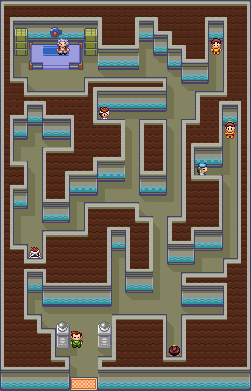
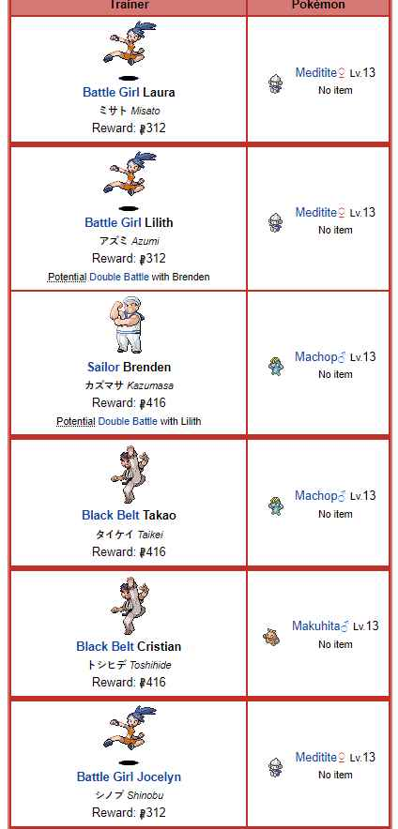
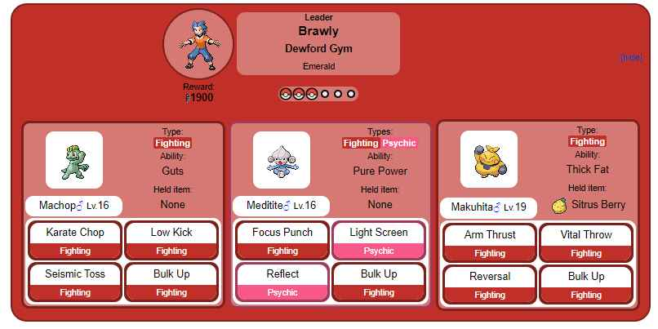
Dewford Gym
Meditite’s only offensive move is focus punch. Just use a 100% accurate damaging move every turn and you can never faint to it.

Slide 31
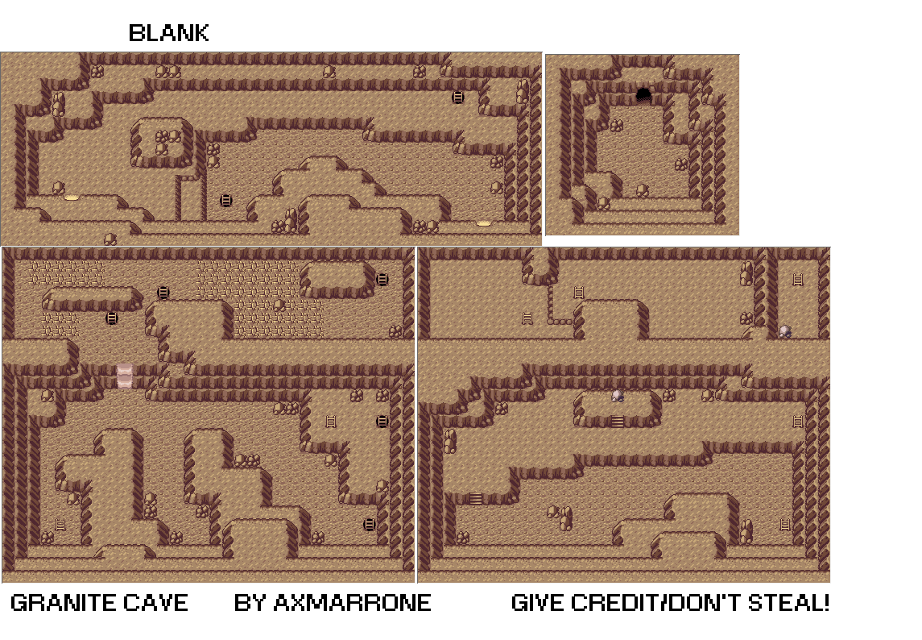
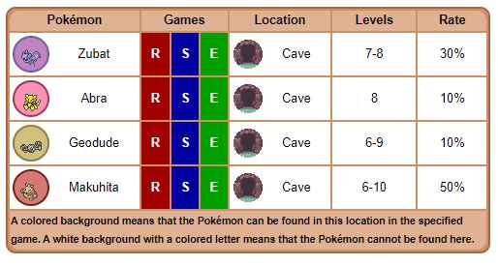
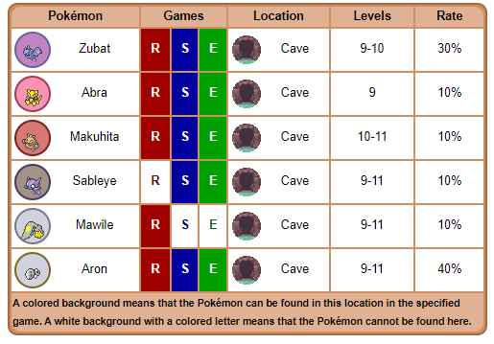
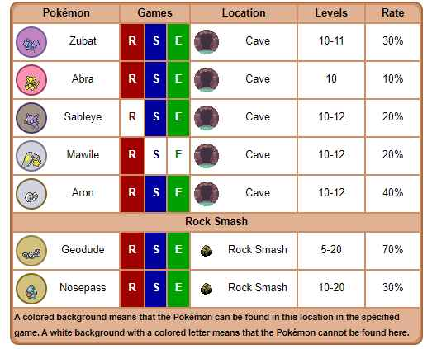

Granite Cave
After the letter is delivered, you can go back to Rustboro and talk Mr. Stone and get the EXP. SHARE
5
Escape Rope
Steven
1
HM05 Flash
(Hiker)
There are a lot of items here we can’t get yet. I am only going to put the ones available now. Follow the path, talk to Steven, use escape rope
to exit. Take Mr Briney’s boat to Slateport City.
1F
Everstone
4
2
Poke Ball
3
B1F
→ B2F
→ Steven’s Room

Slide 32





Route 109
For some reason you have to be facing right to pick up the heart scale.
Talk to the tuber girl for a soft sand.
There are a ton of hidden items on this beach. Use the picture for reference.
This route also technically includes the water south of the beach but I won’t go over that until later.
Beat all 3 trainers in the Seashore house to receive 6 free soda pops and also the ability to buy them. Unfortunately, only 1 can be purchased at a time. But these are well worth it. Stock up.
Potion
Seashore House

Slide 33


Slateport City
Here’s a link to see all the items you can buy in the square for completing various tasks throughout the game.
https://bulbapedia.bulbagarden.net/wiki/Slateport_City
Sailor:
TM41
To the west upon entering is the market square. Items get added to these throughout your adventure. The powder jar is about all there is to be noted. The vitamin store is available to you as well. The girl next to the vitamin seller will tell you if you maxed out your EVs on your pokemon in slot 1. She will give you a ribbon if so.
North of the market square is the pokemon fan club. You can get the Soothe Bell from the lady in the back if your pokemon in slot 1 is very friendly towards you.
The name rater is just north of Pokemon fan club. Change your pokemon’s nickname here.
The battle tent is a battling side game that you can earn some rewards from. I won’t go into detail about how it works because it’s not required and It’s not really worth it to be honest. The items you get from it are kind of trash. But you can get TM41 by just talking to the sailor inside.
Then make your way down to the big grey building and talk to the bald guy at the big table making blueprints for the new ship. Then go to the museum and go upstairs. Beat the 2 Aqua Grunts. On your way out talk to the last remaining Aqua Grunt for TM46 Thief.
BUY A HARBOR MAIL BEFORE LEAVING TOWN to trade for a COIN CASE in Mauville City.
Name Rater
Soothe Bell
Buy a Harbor Mail!
Museum
(story element)
PokeMart Items
Talk to guy at table
before entering
museum
Powder
Jar

Slide 34





Route 110
Mauville City
Ignore Cycling Road for now. I’ll go over it when we get the bike.
Definitely visit the Trick Master House. The first puzzle for it gets you a Rare Candy. You can do a new puzzle for every new badge after the 1st badge. So at this point, 1 Puzzle is available. This needs to be completed in its entirety by the end of the game. I’ll explain more on that much later. They are super easy though and they give good items.
Before going east towards Mauville under cycling road, visit the east side of Route 103 to the West. (Next Slide)
There are a lot of items here. I will also come back to this route AND route 103 once we get Surf to get the items from that.
There is rival battle on this route. It’s actually kind of difficult sometimes. It varies depending on your starter and some other things. They will never start with their starter. They will either start with a wingull, or a slugma typically.
The image for the route is actually from sapphire/ruby technically. I couldn’t find a high quality image for emerald. It’s nearly identical though.
Poke Ball
Elixir
Revive
Great Ball
Rival
Battle
Trick
Master
House
Full Heal
Route 103
(East)
Dire Hit

Slide 35





Route 103 (East)
Guard Spec.
Ignore the cave entrance. This will not be there yet. That is Altering Cave. It becomes available in the post game. Unfortunately, it’s broken anyways so it’s useless. Look it up it’s interesting.
PP Up

Slide 36





Mauville City/Gym
Route 111
Bike Shop
Stop at the first house to exchange Harbor Mail for Coin Case. Then get the X Speed and go to southeast house for HM06 Rock Smash. Then go to bike shop and get the Mach Bike. (Acro will be used much later).
Game Corner has amazing TMs so if you ever the money or coins to get them, do it.
The fat guy standing outside the gym is a Rollout move tutor.
Rollout
Route 117
Route 118
Inside Gym
Game Corner
HM06
Rock Smash
Coin Case
Route 110
X Speed
If you need more training before the gym, there’s tons of trainers on all sides on the city.
PokeMart Items

Slide 37





Route 117
Revive
Day Care
Verdanturf Town
Mauville City
Repel
Great Ball

Slide 38



Verdanturf Town
Fury Cutter
TM45
Attract
PokeMart Items
Little boy in Pokemon Center will teach Fury Cutter.
Friendship rater will rate happiness of Slot 1 Pokemon.
Lady in northwest corner of Battle Tent will give TM45 Attract.
Rusturf Tunnel
(East Entrance)
Route 117
Friendship Rater
With Rock Smash you can now travel quickly between Rustboro/Petalburg and Mauville.

Slide 39

Rusturf Tunnel (East)
Inside the tunnel
Hiker with 2 Geodude and a Machop.
Take the small path southwest and exit to the hidden area.
Pick up the Black Glasses then Talk to the guy.
Go up the stairs on the mountain, grab the HP Up.
Go back inside tunnel and go Northwest (get the Max Ether) and use Rock Smash on the rock and receive HM04 Strength from the guy.
Exit the Tunnel from the West side towards Rustboro and talk to the Devon Corp. Employee for a repeat ball. Head back to Verdanturf then back to Mauville.
HP UP
Repeat Ball
Black Glasses

Slide 40

Cycling Road (Route 110)
Mauville City
Hidden
Trainer
Well, it turns out there’s no information on the trainers here. There are also no items to mention or special NPCs.
Most of the trainers just have Magnemite/Voltorb.
There is actually a hidden trainer that a lot of people don’t know about. Instead of going up the ramp to cycling road (north end), continue east through the narrow path. She just has an Abra.
Go back to Mauville.
Slateport City

Slide 41



Route 118 (West side)
Hidden Heart Scale under the rock.
Go back to Mauville then go north to Route 111.
Heart Scale

Slide 42




Route 111 (South)
Beat the Winstrate Family and talk to the Mom inside the house to get the Macho Brace
Trainers Gabby and Ty can be used as a good source of unlimited money later in the game. Fight them here.
You cannot go into the desert yet. We will also come back to this route with Surf for HP Up later.
The green building is trainer hill. We don’t have access to that place until the champion is defeated. It’s kind of pointless anyway especially since the Battle Frontier exists. It’s basically Battle Tower except there’s some puzzles and you can use items. It yields very mediocre rewards but hey it’s a cool place.
Route 112
Winstrate
House
Elixir
Mauville City

Slide 43




Route 112 (south)
Fiery Path
Nugget
Cannot get nugget yet until we leave Lavaridge Town later.
Continue through Fiery Path, there’s nothing in there for us yet. Strength cannot be used until next gym badge is acquired.
Route 111

Slide 44


Fiery Path
We will come back here with strength later.

Slide 45



Route 112 (North)

Slide 46


Route 111 (North)
Talk to the guy in front of the fake tree to get TM43 Secret Power. You can now make secret bases.
Talk the Old Lady inside the house to heal pokemon.
Go up the mach bike slope to the north to find a trainer. He’s not important but he’s there.
The girl by the berry patch will give a random free berry. I do not think this is a daily berry though.
Tip: In Ruby and Sapphire ONLY, you can actually use all mach bike slopes to get infinite exp from the Daycare. Just approach the slopes slowly while on your mach bike, and hold up and let it bounce you back and forth. If you can find a way to hold down your up button, you can have 2 very high level pokemon legitimately in a matter of hours without paying attention. Can also be used to hatch eggs or gain happiness as well.
If you can find a way to hold up AND your B button down, it’s actually faster EXP to run up the slope instead of use your mach bike. Straight chip-clips usually work well.
This was fixed in Emerald, it will not work in Emerald.
Route 113
Rest House
TM43
Secret Power
Route 112/
Fiery Path
Black Belt Trainer

Slide 47







Route 113
Ether
Nugget
TM32
Double Team
Max Ether
Super Repel
Fallarbor
Town
Route 111
Hyper Potion
Glass Workshop Items
Get the Soot Sack from the glassmaker in the house to be able to pick up ash for his items.
Press A on lumps of ash to get items.

Slide 48


Fallarbor Town
In the Pokemon center, speak to Lanette who is using the PC. She will tell you to meet here at her house on the next route.
Get hidden Nugget in the crater.
The move tutor teaches more previously learned by pokemon that have been forgotten or did not learn. Each move requires 1 Heart Scale.
The little girl in the shop will teach Metronome to 1 pokemon.
Reward for clearing the Battle Tent is 1 Hyper Potion.
Move Tutor
(Heart Scales)
Lannette
Route 114
Route 113
Metronome
Nugget
PokeMart Items

Slide 49






Route 114
Pathing, trainers and pokemon. Items on on the next slide…

Slide 50


Route 114 (Continued)
Rare Candy
TM28 Dig
TM05 Roar
Fallarbor Town
Energy Powder
Revive
Lanette’s House
-Get TM28 dig from the little boy in fossil maniac’s house.
-TM05 Roar from Gentleman with Poochyena.
-Energy Powder after double battle in the trees on east side
-Revive at the end of the path in the corner on the west side.
-Walk behind Lanette’s house for the Persim berries.
-Go into Lanette’s house and speak with her.
-Hidden carbos under the rock below south grass patch
-Protein on first ledge with rock smash
-Cannot get rare candy until surf AND waterfall are acquired.
Protein
*If you ever teach a pokemon dig with the TM, do not ever delete it before getting the Regi Trio. It is a pain in the ass to get access to dig again if you use the TM and forget the move. Honestly, it’s just best not to use the TM.*
Carbos
Meteor Falls

Slide 51



Meteor Falls
Full Heal
Moon Stone
Go up the first stairs for a Full Heal.
Cross the bridge for the story element.
Get the moon stone up the North Western stairs.
Exit the cave to the south to route 115
Route 115

Slide 52



Route 115
We have now come full circle to Rustboro just to the south. If you hop the ledges, you can’t go back unless you loop all the way around again so get everything before you go. We cannot access the northern part yet.
Use rock smash by the blackbelt to get 6 bluk berries.
1 space north of the battle girl on the beach is a Heart Scale.
*On the 5th rematch of Black Belt Nob, his Machamp will be holding a Black Belt which you can take using Thief.
Once ready, jump down the ledges, head to Mauville through Rusturf Tunnel, then go all the way back north to the cable car on Route 112/Fiery Path to continue the story.
Heart Scale
Great Ball
PP Up
Rustboro City

Slide 53



Mt. Chimney
Take the cable car up, exit the building and go north to all the commotion. Beat all the Magma Grunts and get ready for Maxie battle.
Once Maxie is beaten, take the Meteorite from the machine. Exit Mt. Chimney to the south through Jagged Pass.
*On your way out (before Jagged Pass), there will be an old lady right before the exit that sells Lava Cookies for 200 a piece. These are Full Heals for 1/3 the price at a mart. Stock up.*

Slide 54




Jagged Pass
Full Heal
Burn Heal
Great Ball
Lavaridge Town

Slide 55



Lavaridge
There is an exit in the northwest corner of the Pokemon Center. Go through to get the Ice Heal.
Talk to the Old Man in the Herb Shop to get the Charcoal.
Talk to the little boy in the southeast house if you want a pokemon to learn Mimic.
Take the egg from the old lady at the sand beds. If you keep it with you, it should hatch by around Fortree City at this point or just shortly after if you skip stuff.
Ice Heal
Egg
Herb Shop
and Charcoal
Mimic
PokeMart Items
* Herbs are very good items. They are extremely cheap compared to normal pokemart items and you can buy bulk. A Revival Herb is the equivalent of a Max Revive which is not a buyable item. Herbs lower a pokemon’s happiness rating, but if you don’t have pokemon or moves that depend on happiness, there’s no reason not to buy all of your high level healing items from here to be honest. (In case you hadn’t noticed, it’s good to save money for TMs from the game corner BEFORE you have access to the item duplication glitch and before the Elite 4).

Slide 56





Lavaridge Gym
6
5
7
4
3
1
8
2

Slide 57


Leaving Lavaridge
Get the Nugget by hopping down 2 ledges on the way out of Lavaridge to the west.
Make your way back to the top of Mt. Chimney. There are new trainers there.
Go all the the way back to Fallarbor Town via Fiery Path to Deliver the Meteorite back to Professor Cosmo. He’s in the Southwest house. He will give you TM27 Return which is an amazing move if your pokemon have high happiness.
Go east towards the desert from Fallarbor and go into the desert. You do not need to go through Fiery Path here if you have a Mach Bike still.
←New Trainers at Mt. Chimney
Fiery Path:
Now that Strength can be used, we have access to the west side of Fiery Path containing TM06 Toxic, and a Fire Stone.
TM06 Toxic
Fire Stone

Slide 58






Desert (Route 111)
Mirage Tower
-This place appears at random only in Emerald. If it isn’t there, just exit the route entirely (actually touch route 112) and come back to refresh it and see if it’s there. Keep doing this until it appears. You need the Mach Bike and Rock Smash to get to the top and get a fossil.
Protein
Stardust
Mirage Tower
Rare Candy
Stardust
Trainer info on the next slide…
TM37 Sandstorm

Slide 59


Desert (Continued)

Slide 60




Petalburg Gym
Once fully done with all post Lavaridge activities, head back to Petalburg City. There’s nothing to do in the game besides fight this gym.
Once the gym is completed, at last we have access to Surf. The next few slides will be dedicated to all areas that are available via Surf.
Even though we don’t have the good rod yet, it is now accessible. (surf east of mauville talk to one of the fisherman on the beach). Every route that has water on it, Good Rod fishing encounters will be added to the wild pokemon list of each route.
Norman is actually difficult. Use setup methods on spinda/Linoone. Put a Persim berry on your starting pokemon and use X Items or use stat buffing moves while Spinda tries to confuse you. He usually likes to spam teeter dance so just keep setting up until he finally starts using facade too many times. Linoone likes to use Belly Drum on its first turn which leaves for some set up there.

Slide 61

Surf - Petalburg City
Max Revive
Rare Candy
Ether

Slide 62


Surf - Route 104 (North)
White Herb (if you haven’t gotten it yet). Talk to the girl outside flower shop.
PP Up

Slide 63


Surf - Route 115 (North)
Heal Powder
TM01 Focus Punch
Iron (Mach Bike)
After this, go to Route 111 (Winstrate House), via Rusturf Tunnel.

Slide 64

Surf - Route 111
HP Up
Go to Mauville after this and talk to Wattson in the middle of the town to receive the Basement Key.

Slide 65

Surf - Route 118 (East Side)
Do not go further East than the beach yet.
Good Rod (Fisherman)
Iron

Slide 66

Surf - Route 110
Enter New Mauville with Basement Key.
Go to next slide

Slide 67




Surf - New Mauville
4
3
2
1
Numbers are the order to hit the buttons.
Hit red button at the end to complete Wattson’s task.
Use Escape Rope/Dig
Talk to Wattson for TM24 Thunderbolt.
Go south, walk or take cycling road to the south end of Route 110

Slide 68
Surf - Route 110
Rare Candy
Do available Trick Master Puzzles

Slide 69




Surf - Slateport to Dewford (Route 109)
Slateport City
Heart Scale
PP Up
Route 108

Slide 70



Surf - Slateport to Dewford (Route 108)
Route 107
Star Piece
Rare Candy
Ignore the Abandoned Ship for now. Dive is required to finish the side quest there.

Slide 71



Surf - Slateport to Dewford (Route 107)
Dewford
Town
No items on this route.
When you get to Dewford:
Get TM36 Sludge Bomb inside Dewford Hall from the guy with the glasses near the entrance.
Go inside Granite Cave (Need Mach Bike, and Flash is recommended).

Slide 72


Surf - Granite Cave
Note: You don’t have to ride the mach bike on those exact tiles or anything. It’s just showing the route to take.
Use Escape Rope
Go down the first ladder to the west.
Go to the North wall where the Mach Bike slope is and go up.
Go down the first ladder. Get the repel.
Follow this path to the Rare Candy.
Get the Everstone.
If you fall just go back up the ladder and try again

Slide 73



Surf - Dewford to Petalburg (Route 106)
Protein
Stardust
Heart Scale
Poke Ball

Slide 74




Surf - Dewford to Petalburg (Route 105)
Iron
Heart Scale
Big Pearl
*Once you hit shore, go to your house in Littleroot Town. Talk to Mom and get the Amulet Coin. You might need to talk to her twice.*

Slide 75



Surf - Oldale to Route 110 (Route 102 & 103)
Route 102 water:
Route 103 water:
After getting the Amulet Coin from your mom, head north past Oldale to the water on Route 103.
No items
Surf to the other side to reach route 110. From here head back to Mauville. The surf section is now done thank God. I always hate that part of the game tbh.

Slide 76



Fishing - Meteor Falls, Route 114
*I didn’t include these in the surf slides because there are no items we can get yet, or new trainers. They just weren’t very important and they didn’t fit the optimal routing. But these are the only places you can get Barboach, so there is that.*

Slide 77

Fishing - Route 117
*Also this route*

Slide 78





Route 118
Route 119
Hyper Potion
Mauville City
Route 123
(West)
This is the 2nd location of Gabby and Ty. Fight them here. We already grabbed items on the beach.

Slide 79


Route 123 (West side)
We cannot access most of this route quite yet. The berry master’s house, a few trainers, and a couple items are available. I wanted to use this slide for the berry master’s house.
First get the berries from the garden.
Go inside the house and get 2 random berries from the berry master. All the ones he can give you are only used for PokeBlock ingredients later. Some also decrease a Pokemon’s EVs in the associated stat.
The berry master’s wife will give you certain berries based on text that you tell her. Options continue to open up from completing certain activities in the game.
Right now, the only phrase we have access to is “Great Battle” for a Spelon Berry.
There is a hidden Revive behind the garden in the left corner. Walk behind the house.
Unfortunately, both the berry master and his wife are time based events. If your internal clock battery is dry, you can’t do anything else here. So unless you have a working battery or using an emulator you can’t get any more berries here which is ridiculous but that’s the way it is.

Slide 80





Route 119 and WI
*This route is huge. More on the next 2 slides.*

Slide 81




Route 119 and WI (Items)
I’m putting all the items regardless of not having waterfall or the Acro Bike at the moment. There’s so many, and I don’t want to make more slides about this route lol.
South of Big bridge
North of Big Bridge
Fortree City
Rival

Slide 82




Route 119 and WI (Continued)
Inside Weather Institute.

Slide 83


Fortree City
Wingull
Side Quest
Trade Volbeat
for Plusle
TM10
TM10 - Old Lady; Right, Right, Left
Her Husband is a Sleep Talk Move Tutor
Once explored, go to Route 120 to the East.
Route 119
Route 120
Secret Base Shop
PokeMart Items
Do not trade Volbeat for Plusle. This super important for later.

Slide 84




Route 120
Rare Candy (Cut)
Revive
Devon Scope
Nest Ball
TM11 Sunny Day (inside cave)
Fortree City
Do not continue past the bridge after getting Devon Scope from Steven. Catch the Kecleon for Pokedex, then Go back to Fortree Gym.
*This is the last location of Gabby and Ty. Once you defeat the gym, you can use Fly to quickly go to all 3 of their locations and battle them. You can use an Amulet Coin on their battles over and over. Once they are maxed out, you can get like 6 or 7 grand per battle.* Yes. Unlimited money, and technically, experience too.
There’s a lot of trainers on this route, the rest will be on the next Route 120 slide.
Route 121

Slide 85



Fortree Gym
Winona starts with Swablu. Take it out immediately before it uses Perish Song.
Pelipper loves using Protect especially when it first gets sent out. You can set up on it for 2 turns like 90 percent of the time.

Slide 86


Route 120 - Trainers and Items
Fortree City
Revive
Zinc
Nugget
Hyper Potion
Full Heal
Rare Candy
Lady by this berry patch gives you a random rare berry. I’m not sure this is a daily berry.
Route 121

Slide 87





Route 121
Safari Zone
Lilycove
City
Route 120
Mt. Pyre/
Route 123
Zinc
Revive
Carbos
Nugget
Full Heal
Max Revive
Safari Zone cannot be accessed until Pokeblock Case is acquired in Lilycove.
Keep going past Mt. Pyre go straight to Lilycove.

Slide 88



Lilycove City
Aqua
Hideout
Move Deleter
Rival
PP Up
Daily Berry
Too many items to list for Department Store. It’s pretty standard stuff.
This is the last Rival Fight in the game.
I will do the contests much later.
Head back to Route 121 pier south of the Safari Zone when done. Bring a pokemon with Cut and any Grass Type pokemon. Surf south an enter Mt. Pyre.
TM44 Rest
Route 121
Contest Hall and
Pokeblock Case
Heart Scale
PokeBall
Max Repel
Now that we have the pokeblock case, we can go to the safari zone on the way to our next destination. I’ll go over it on the next slide.

Slide 89





Safari Zone
Honestly, I recommend just throwing safari balls. I wouldn’t bother with pokeblocks or the “go near” option. The safari zone in this generation isn’t too bad. Only Wobbuffet, Heracross, and Pinsir are hard to get. Pikachu isn’t too difficult because it has a decently high catch rate.
Areas 5 and 6 are not accessible until after the Champion is defeated and received the National Dex.
Areas 2 and 3 need Mach Bike
Areas 1 and 4 need Acro Bike

Slide 90



Safari Zone Items
No items in area 1

Slide 91










Mt. Pyre Interior
1F 2F 3F 4F 5F 6F
Cleanse Tag (Old Lady)
Ultra Ball
Super Repel
TM30 Shadow Ball
Lax Incense
Sea Incense
Fall down the southernmost holes on the way down.
Leave out the western exit on 1F to exterior.

Slide 92


Mt. Pyre Exterior
Continue up all of the stairs to reach the summit.
Ultra Ball
Max Potion
Max Ether
TM48 Skill Swap

Slide 93



Mt. Pyre Summit
Rare Candy
Zinc
Go to Route 123 just south of Mt. Pyre after this. (Walk, Fly to Lilycove).

Slide 94



Route 123 (East)
There’s an absurd amount of items and the graphic is huge because of ORAS. I’m just going to list them.
Mt. Pyre/
Route 121
Note: You must come here twice to get all the items. You can get the first 8 items in one go.
Rare Candy
PP Up
TM19 Giga Drain (Girl NPC) - show her a grass type pokemon
Hyper Potion
Super Repel
Elixir
Calcium
Revival Herb
PP Up
Trainers on next slide

Slide 95




Route 123 (East) Trainers

Slide 96




Magma Hideout (Jagged Pass)
Bring Mach Bike
Fly to Lavaridge, then take the cable car up mt chimney. Go south into jagged pass and enter the new cave entrance with the magma seal. All the grunts in here are pretty trash. I’m not going to list all of them, there are a LOT. I’m only going to put the Admin/Boss Fight. Both fights happen back to back on BF4.
Follow ALL green paths first, then take the south exit in 1F, then follow all light blue paths. Go through B3F, then follow red path to the end. Beat Maxie then use Escape on B5F. You will not miss any items if you follow the path. None are hidden.
After you are done with this place, go to Slateport Harbor and talk to captain stern.

Slide 97





Aqua Hideout (Lilycove City, North East Corner)
3
1
12
Two Electrode disguised as pokeballs
5
Master Ball
7
6
11
9
2
Nugget
Max Elixir
8
10
13
4
Admin Matt is right after Teleporter 17.
Leave through teleporter 18 then the stairs when Matt is defeated.
17
16
Nest Ball
15
14
18

Slide 98



Route 124 (No Dive)
We now have access to the Super Rod if you want to make a dash for Mossdeep City all the way across the water. It’s located in the North Eastern most house there. All trainers are skippable except the Swimmer Declan right at the start of the route. I haven’t been including pokemon you can find by Super Rod in the encounter lists because we didn’t have access to it yet AND haven’t been able to catch anything new with it, or couldn’t evolve already from a good rod.
Pokemon you have access to via Super Rod right now that are brand new is Staryu from fishing anywhere on Lilycove Beach.
The only other brand new pokemon you can get with it, if you want to skip to them, are Corsola on Route 128, Luvdisc Route 128, and Horsea fishing anywhere west of Pacifidlog Town. (route 132)I’ll have those routes on later slides of course. But everything in the game (Town/City wise) is accessible at this point except for underwater areas which includes Sootopolis City that holds no new pokemon from fishing at all.
Read Carefully —>
There are no items on this route without using Dive which we do not have access to yet.
There is the Treasure Hunter’s house on an island just west of Mossdeep. You can trade shards for his evolution stones. We also need Dive for this.

Slide 99




Route 125
Shoal Cave
Big Pearl

Slide 100





Shoal Cave
We are unable to get the ingredients to make a Shell Bell. In order to make one of those, you have to visit shoal cave on both tides which you can only do with a working clock battery or on emulator. But we have all we need set up for completion because we set our time to 3pm (or 3am) on our room clock at the start of the game. In order to catch Snorunt, shoal cave must be on low tide to get to the lowest floor of the cave. There’s also good items down there. You can catch Spheal on both tides which is really nice how that works out for dry batteries. Don’t bother wasting inventory space picking up shoal salt/shells. You can’t do anything with them with a dry battery.
When tide is low, it’s very easy to navigate. There’s only one way to go essentially. Just keep going down any ladders you find and don’t jump down any ledges. Once you get to the Black Belt NPC, talk to him for a focus band. Then go east and push the boulder to the wall, go south through the next ladder. You will now be on the ice floor where Snorunt is. I can’t really put how to do the ice room. Just slide until you get it. Just get all the items and look for Snorunt. (cannot encounter wild pokemon on ice tiles). No items are hidden.
Focus Band
Follow the green path, then the blue path.

Slide 101



Mossdeep City
PokeBlock
Enthusiast
Super Rod
Steven Stone’s
House
Kings Rock
Talk to man
Secret Base
Location (Boy)
Wireless
Communication
Mini games
Fortree/Mossdeep
Wingull Side
Quest
Dynamic
Punch
Tutor
Net Ball
PokeMart Items
Secret Base Boy tells you the location of your secret base in case you forget.
Talk to man around the trees by PC for a King’s Rock.
PokeBlock Enthusiast tells you which Pokeblock your pokemon in slot 1 likes the most.
Super Rod Northeast house.
Net Ball southeast corner.
Wingull Side Quest: If you didn’t speak to the boy with a Wingull in Fortree City in the Easternmost Treehouse on the northern bridge, do that, then come to this house. Speak to the Wingull here, and everyone else inside, then go back to Fortree to the boy and receive a Mental Herb.

Slide 102





Mossdeep Gym
Just go to each room and move the statues so there’s an open path to each teleporter.

Slide 103



Mossdeep Space Center
After the gym battle, Team Magma will appear in the southeast part of the city. Follow them inside the space center. Fight them all. Then the best battle in all of Pokemon history happens on the 2nd floor. If you have a guard spec, I would suggest using one on yourself your very first turn for this fight.
*On your way out, talk to the Sailor on the 1st floor. He will give you a Sun Stone.
Go to Steven’s house (north western house) and he will give you HM08 Dive.
At this point, fish with a Super Rod anywhere on Mossdeep coast and catch a high level Wailmer. You can find them up to level 40. Level 38 or 39 would be fine too. Ideally you want to use as little rare candies as possible. But ultimately, you need a Wailord. It evolves from Wailmer at level 40. So catch one, use rare candies on it until it evolves. Store it in the PC for now, or keep it with you because it can learn almost every single HM.

Slide 104
Housekeeping slide
There is a TON to do right now on all these water routes. I’m going to ignore everything for now and ONLY do the story until we get all 8 badges and get access to the Waterfall HM. So many trainers, so many items…I am going to come back to these routes one by one just like the Surf slides from earlier starting with Lilycove City.
For now though like I said, just the story for now. Let’s get access to everything.
Make sure you have Dive, Surf, Rock Smash, and Strength in your party and head south on Route 127.
Feel free to fight swimmers for exp. They don’t really need a bio. They shouldn’t pose any issues. There’s probably 30 of them in total around these areas. So many…

Slide 105

Route 127 and 128 (Story)
Follow the dark water all the way down to when you hit route 128. Keep following the path of the dark water to the East and then southwest again until you come to a square of dark water that makes an “x”. Use Dive right in the middle and head into the underwater cave entrance where the stolen submarine is. Use Dive (press B) again in this cave to resurface into Team Aqua’s Base. Go north into the entrance. (Seafloor Cavern).

Slide 106




Seafloor Cavern
Map on Next slide.

Slide 107









Seafloor Cavern Routing
Talk to the dude grunt where Shelly is to not fight her in a double battle if you want. Unfortunately, this guy is NOT Matt. That would have been so sick though…
Shelly
Strength Puzzle Room
TM26
All these rooms are more fake than Kim Kardashian’s poop deck.
There are no items here. Only TM26 Earthquake which you cannot miss. It’s right in your face in the very last room.
Follow the green path exactly. The pictures go in order. There are fake entrances here that warp you to the start of the entire place where you originally came up from Dive.
Shelly is technically optional. You can do the strength puzzle instead but this is the last time you see her, so why not?
Almost all the trainers here are optional. You can fight them all if you want. But just take the green path ultimately.
Archie Battle

Slide 108



Going to Sootopolis City
After the cutscene and Steven Stone talks to you, Surf as far South as you can go and all the way West as far as you can until you reach Pacifidlog Town. (If you haven’t been here yet). It’s handy to go there first so we don’t have a long surf to it later.
After you have arrived there, or if you have already been there, Fly to Mossdeep City.
Take this path from Mossdeep to get to Sootopolis. Use Dive where the Green circle is.
*This is a good opportunity to search for Relicanth in the Seaweed around this cave entrance. It’s a 5% encounter rate, and is required for the Regi-Trio. Which also why we got Wailord earlier. Good luck.*
Otherwise, enter the underwater cave. Resurface inside. A cutscene will play.
Treasure
Hunter
House
This is everything you can find in the seaweed no matter where you are diving. Seaweed always yields the same 3 pokemon with the same encounter rates no matter what.

Slide 109


Cave of Origin/Sky Pillar
After the cutscene in Sootopolis, Surf Northwest and talk to Steven, he will lead you to the Cave of Origin. There’s nothing in here, just follow the paths through each cave entrance/ladder.
Once you get to the foggy room with no music go south and talk to Wallace and select the Sky Pillar option.
Escape Rope, Dig, or run out of the cave then fly to Pacifidlog Town and start surfing East on Route 128.
Follow this path to get to Sky Pillar
Again, nothing here (yet).
Follow path talk to Wallace.
Once inside, go up all the stairs.
When you get to this room fall down one of these cracks in the floor.
Continue up the stairs. Once you reach the top, talk to Rayquaza (this is a not a battle, no need to save or anything). Then fly back to Sootopolis from here for a long cutscene to end the story of the game.
Talk to Archie and Maxie, then Wallace to get HM07 finally! Unfortunately you have to beat the gym for the city to return to normal. There will still be people blocking some paths. Don’t know why they did that.

Slide 110





Sootopolis City (Back to normal Guide)
TM31
Brick Break
The gym will be on the next slide. You can get Brick Break before you Vs. the gym. I’ll put all the items still though.
Seedot/Lotad
Elixirs (repeatable)
Wailmer Doll
PokeMart Items

Slide 111






Sootopolis Gym
Hit all the ice tiles exactly once and end at the slopes to get the stairs to appear. If you want to Vs all the trainers you have to fall down.
If you have a pokemon with thief, there’s some nuggets that their pokemon are holding. Remember that you cannot be holding an item while you use thief for it to be able to take their item.

Slide 112
All items Before Ever Grande City
This might be a lot of slides. get ready…
We are going to start at Lilycove East Coast and work our way East and South, then west towards Pacifidlog Town, then West to Slateport City.
*Don’t forget about the Rare Candy on Route 114 just West of Fallarbor Town up the Waterfall. As well as the Acro Bike and Waterfall areas on Route 119 (North) just West of Fortree City. There is a nugget and a Rare Candy up there. And the waterfall that leads to a cave entrance inside meteor falls also has items and new pokemon. Look at the previous slides for those item locations.*
I’ll actually go over Meteor Falls right now on second thought. Next slide.

Slide 113






Meteor Falls (Waterfall)
When you get to Meteor Falls go up the waterfall and through the cave entrance at the top.
*Dragon Tamer Nicolas is very important. I Believe he is the only way to get a Dragon Fang in the entire game. His Shelgon will be holding one on the 4th time you face him (3rd rematch). Use Thief to take it. These types of items aren’t essential of course for completion. Rematches are just very hard to activate because they are kind of broken and super random.
Go up green ladder for TM23 Iron Tail
B1F 2R
B1F 1R
1F 2R
TM02
Dragon Claw
To Dragon Claw…
To PP Up

Slide 114


Route 124 (East of Lilycove)
If you go down the fake dive spots, or enter a fake area because you don’t trust me….you’re an asshole lmao. I wasted my time so you don’t have to waste yours!
Dive and Surf Needed, GET REPELS if you don’t have any
Red
Shard
Yellow
Shard
Fake
Blue Shard
Fake
2nd Green
Shard
Blue Shard - Go all the way south then all the way west. Resurface where there is light. The first resurface spot to the south is fake. There’s nothing up there.
Carbos is on the way to blue shard to the right on your way south underwater. Empty square of Seaweed.
Red Shard - The furthest north and west you can go after diving. Resurface in the light.
Calcium - Go east after diving once you get the red shard. Dark spot where the light is, which is also a fake resurface spot.
Fake Area
There’s only 1 path to take for the 2nd green shard. You can’t get lost. I can’t put it on the map because the item itself is technically on the next route (south). You do have to dive twice. Just dive where you can, resurface where you can.

Slide 115


Route 126 (Around Sootopolis)
Surf and Dive needed
Heart Scale/Pearl/Iron/Yellow Shard - Dive at yellow circle, go north then east. Heart Scale in the dark circle. Resurface. Go South-West, Dive for Yellow Shard, Iron, and Pearl In the dark spots.
To Heart Scale
And Yellow Shard
Blue Shard

Slide 116



Route 127 South of Mossdeep
Surf, Dive required
Dive on the spots where the lines end for each item. Look around for the rocks. The lines are pointing very close to them.
I don’t think I need to list every swimmer. They suck and there’s a lot.
When you get the rare candy, either talk to the trainer on the left or initiate the double battle on the tile right next to her; or else you can’t get through and will have to reset the route.
There are no new pokemon on this route
To Carbos…
Underwater Items below

Slide 117




Route 128
?????
I looked everywhere. There is no 3rd heart scale. I don’t know what it’s talking about. I even used the itemfinder absolutely everywhere. No detection. I only found 2. The one I can’t find is the one supposedly on the west side of the ring shaped island.

Slide 118

Route 129
Nothing here just trainers. Go west to route 130.

Slide 119

Route 130
Nothing here either.
Unless you are literally the luckiest human being alive. It’s a 1 in 65,000 some odd chance of having Mirage Island appear on Route 130 on your save file. The Liechi Berry that is there is a pretty insane item though. Other than that, all can do there is catch wild Wynaut.

Slide 120

Route 131
More trainers. That’s it.

Slide 121


Sky Pillar (2nd Visit) (slide 1)
Refer to slide #6 for manip guidelines!
Since we are passing by, we can pay Sky Pillar a real visit now. The place is back to normal.
*Need Mach Bike and a Masterball*
You do not need to use a Masterball if you don’t want to RNG manipulate a Rayquaza. Buy Ultra Balls.
I will be RNG manipulating one myself. Manipulating the Static Legends is really nice for easily completing Pokemon Colosseum/XD post game. Especially Mt. Battle to get Ho-oh in Colosseum specifically.
Need FlowTimer and Pokefinder again. It’s very easy just like Mudkip. Takes a little longer though on the timer for the one I really like getting.
Here’s the Rayquaza I like. Frame 14745.
And the time I use for it on FlowTimer.
245.287
Use the same procedure as our Mudkip.
Save before talking to Rayquaza
245287
245287
IVs - 18 hp, 21 Atk, 31 Def, 31 SpA, 21 SpD, 31 Spe

Slide 122





Sky Pillar (2nd Visit) (slide 2)
Enter Sky Pillar go up all the stairs again. This time though you need to use your mach bike fairly precisely to work your way up. Fall down those same cracks to get to the middle staircase just like before. Here are the wild pokemon you can find here. There are no items.
When you take the orange path, just keep going up and hit the wall. That’s the easiest way. Then reset your bike to where the red line is. Then get speed from there and fall through one of the holes in the red circle.
You have to connect the green path and the orange path in one go without stopping.

Slide 123



Pacifidlog Town
If you trade your Bagon for a Horsea dude…like, that is just treason bro. C’mon big dawg…. You can literally catch Horsea with a super rod on Route 132, like 5 surf steps west of this town if you want one that bad.
Explosion Move tutor inside PC.
Explosion
Return/
Frustration
Trade Bagon
For Horsea

Slide 124





Route 132/133/134
Yeah…this route sucks. I’m leaving this image here…follow the paths exactly. They take you in every possible place you can go. I would take each route color one at a time. Dots are places you can move freely. I’ll put the list of items and you can check them off on your own. There’s no hidden items. They are all inside visible pokeballs. Skip the one Dive spot in the southwestern part. We will go there later.
Route 132 pokemon only. The others have nothing notable or new.

Slide 125
Trick Master House
Since we arrive back at Slateport after that monstrosity of a route, may as well do any remaining Trick Master House rooms. There is still one left to do after beating the champion as well. Right now the one with the teleporters is the most current for the 8th gym badge.

Slide 126




Abandoned Ship (Route 108 East of Dewford)
Enter Abandoned Ship. Make sure you have Dive.
This needs 2 slides because it’s kind of crazy.
I’ll go back to having trainer info in victory road I promise. Just not necessary as of late.

Slide 127




1F
B1F East Side
Dive Ball
B1F West Side
Storage
Closet
Revive
Harbor Mail
Start in Room 3. Every time you enter a room you will see sparkles. Those are either Room Keys or they are just junk. Pick up all the Room keys from each room. And get all the normal items. You can’t miss them, none are hidden except the room keys. Room 2 is the last key to get which contains the scanner. Go back to the captains office and talk to the guy.
Go into the Storage Room before leaving to get TM13 Ice Beam.
Once you get out of the ship, fly to Slateport City and talk to Captain Stern inside the Harbor. You will have the choice between a Deepseascale and a Deepseatooth. Both of these items evolve Clamperl into their respective evolutions while having it hold these items during a trade.
Escape Rope
Captains Office
After you have been in all the rooms and got the Storage Key, go to the room with water and use dive. Resurface through the tunnel to the west.
Storage Key

Slide 128
Everything in the game in terms of items, trainers, and extras are done as of this point. All that’s left is Victory Road, Elite 4, and post game.
Let’s actually do something fun now and go catch some legendary Pokemon
n

Slide 129
Unlocking the Regi-Trio Ruins
Requirements:
Surf, Dive, Dig in your party
Wailord AND Relicanth in your party
*If you don’t have a Pokemon with Dig, the TM for Dig is in the Fossil Maniac house just west of Fallarbor Town. If you used the TM already and forgot the move, well…the only way to get dig in the game other than trading either the TM or a pokemon that knows it from another game, is to catch either a Nincada or a Trapinch. Both of these Pokemon learn Dig naturally through level up. Unfortunately not until level 45 for Nincada and level 41 for Trapinch. Yeah….*
You can rng manip the Regis for good nature and IVs if you want . I don’t normally do that for them myself. So I won’t be going over frames for them. But feel free to use pokefinder to get one you want.

Slide 130
Regi-Trio Ruins
Get your requirements from the previous slide into your party then fly to Pacifidlog Town.
We are back to this picture. We are going to Dive in that one location this time in the southwest. Take the red path to the dive spot in the yellow circle, then use Dive and go south until you reach the Braille sign. Resurface at the sign.
Once you are inside the cave, go all the way to the north wall and stand in the center of the 3 Braille texts. Read it.
With Wailord in your FIRST party slot, and Relicanth in your LAST party slot, use Dig right on this spot.
Enter the new cave entrance and read the Braille on the north wall. There should be a cutscene and some text saying some doors unlocked far away.
Everything is set up now. Dig out of here and resurface all the way back to where we started once we used Dive. Then Fly to Dewford Town. Also, buy a LOT of ultra balls unless you have extra Master Balls from other games.

Slide 131


Regice
I recommend bringing a pokemon that knows a status move (paralyze, or sleep is best).
From Dewford Town, go all the way north. Then Surf West and north to route 105
This picture shows Route 105 here. We are going to this new cave entrance.
Once you are inside the cave, read the middle Braille on the north wall.
Walk a perfect lap, from here, around the edge of the cave counterclockwise. Once you make it back to the center braille, the cave will open.
Save before talking to Regice.

Slide 132

Regirock
Requirements:
Rock Smash
Recommend status move (Paralysis or Sleep preferably)
Fly to Lavaridge Town and go all the way East to the Desert. To the far south in the desert, you will find the new cave entrance amongst the ruins. Enter and read the middle braille on the north wall.
From here, walk exactly 2 spaces left and 2 spaces down, then use ROCK SMASH on this tile. The cave will open.
Save before talking to Regirock

Slide 133

Registeel
Requirements: Flash
Recommend status moves (Paralyze, Sleep)
Fly to Lilycove City and go as far West as you can into route 120. Go north up the stairs by the berry patch and go all the way north the ruins where the new cave entrance is. Go inside and read the middle braille on the north wall.
From here, walk directly to the exact middle of the room and use Flash. The cave will open.
Save before talking to Registeel.

Slide 134


Going to Victory Road
Requirements: Surf, Waterfall
Fly to Mossdeep City, then surf south on route 127. When you hit route 128, keep surfing as far east as you can go and go all the way through the corridor which leads to Ever Grande City and the big waterfall. Go up the waterfall. You can now fly to this pokemon center if you select the bottom half of Ever Grande City on the fly menu. (top half for pokemon league once you get through victory road).
EGC wild pokemon
Route 128 and Ever Grande City

Slide 135



Victory Road Trainers
Before we enter, here’s all the trainers in victory road. Refer back to this slide for your current trainer battle if you need to. (Not including Wally, he’s covered soon).

Slide 136



Victory Road Wild Encounters
Check what floor you are on when you get to a new ladder. Here’s what you can find where you are at.
Mawile is the only brand new encounter anywhere here.

Slide 137



Victory Road (First Floor)
This one will be a few slides.
Requirements:
Surf, Waterfall, Strength, Rock Smash, (Flash technically optional). yeah they were not fooling around here with victory road in this generation.
Head north from the pokemon center and enter the cave.
Wally
Battle
Max Elixir
Wally can be rematched as many times as you want after the champion is defeated. That’s what all these extra levels are
Follow this route to start. Stop when you go down the first ladder north of Wally battle. The next slide will have the floors altogether on one slide and I’ll show the routing.

Slide 138



Victory Road Routing
Black = required, or items near/on required path
Green = leads to items not on required path, extra trainers
Red X = waste of time, don’t go there
Other colors = connecting ladders
You are here (1)
1F
B2F
B1F
Max Repel
Full Restore
Elixir
To TM29
Full Heal
TM29
Psychic
To PP Up and
Ultra Ball
PP Up
Ultra Ball
You are now here (3)
You are now here (2)
You are now here (4)

Slide 139
Elite 4 Preparation
Persim Berries
Cheri Berries
X Attacks
X Specials
Guard Specs.
X Speeds
Hyper Potions
Revives
Full Restores/Max Revives help for really sticky situations
Honestly the easiest way to beat the Elite 4 is to plan for sweeps. At least try it to start and most of the time it will work out. Pretty much all my strats involve setting up on their first pokemon.

Slide 140

Elite 4 - Sydney
Starts with Mightyena
A persim berry on your pokemon helps quite a bit here. Shiftry loves using swagger
Could use a guard spec on very first turn against Mightyena. It likes using sand attack.
Aerial Ace is a really good move here. instead of using guard spec., you can use an X attack.

Slide 141

Elite 4 - Phoebe
Starts with Dusclops
Definitely put Persim Berry on your first pokemon.
Easy stat buff set up here. Dusclops almost always uses Protect at least once if not twice. Stat buff/X items until she uses confuse ray.
Shadow Ball/Crunch all day against her.

Slide 142

Elite 4 - Glacia
Starts with Sealeo
Cheri Berry on pokemon is helpful here.
You can set up here too but try to be quick. She almost always uses Hail on the first turn, AND right after it wears off after she uses it. Be careful of Encore. X Items are preferred because of that. Sealeo can’t really do any big damage but Body Slam paralysis is imminent.
Set up, wait for cheri berry consumption/low health, heal, go to town. Thunderbolt is amazing here.

Slide 143

Elite 4 - Drake
Starts with Shelgon
Similar to Phoebe’s Dusclops, his Shelgon almost always uses Protect once or twice to start. Use an X special/X Attack and then an X speed. If he uses rock tomb to start, which is rare, it’s a really hard fight.
If you get the protect setup, use Ice beam all day.
Calm Mind is good here instead of X items as an alternative.

Slide 144

Champion - Wallace
Thunder. Best move here.
Wailord almost always uses Rain Dance to start. This will give 100% accuracy to Thunder. If he doesn’t use rain dance you will most likely survive his attack even still. Use an X special turn 1 just in case he uses rain dance.
If you only have Thunderbolt just use an X special/calm mind, or maybe even an X speed.
Whiscash - any grass move will hurt
Ludicolo - Aerial Ace/Shock Wave is your friend here.
You can set up x attacks for days on Ludicolo because he just spams double team most of the time which doesn’t matter at all if you have Aerial Ace.

Slide 145
Housekeeping Slide
Alright we finally made it through the main game. We’re almost done. The post game really doesn’t have that much content so it should be pretty quick. The Battle frontier itself is a lot of content but that’s easily 90 percent of the post game content. I consider the Battle frontier just 1 thing in the post game.
At this point when I got to the Hall of Fame, I had 132 pokemon (out of 202) and I didn’t even grind out any training at all. I just caught everything on each route, and traded all the exclusives and evolved anything that was really quick like stone evolutions or trade evolutions. I’m pretty sure I had every stage 1 pokemon. Including most baby pokemon. So I’m already good to go. So that should give you an idea of around how close you can be to the Hoenn Dex completion even on just a normal playthrough without grinding out evolutions. I caught any evolve forms I came across in the wild as well. The goal is to complete the Hoenn Dex then the Battle Frontier. After that all there is to do is trade the National Dex pokemon over from all the other games. Obviously I can’t really put a guide for that. You just have to get them and trade. Some really notable pokemon though, I WILL go over.
Right now, at this moment, we need to get to the Battle Frontier as quickly as possible because we need to duplicate items. Then i’ll go over everything we can do that ISN’T the Battle Frontier.

Slide 146
Back in our room
Go downstairs to have a meeting with your parents, you will get the S.S Ticket then the TV will come on.
Select RED to this message. I promise.
Do not select Blue. I know you want to select blue. Don’t do it.
Once you leave, Professor Birch will give the National Dex upgrade.
I pretty much just ignore the National Dex until the Hoenn Dex is done. You can set the Pokedex to “Hoenn Dex” by opening your pokedex and pressing select to open up the search function. Change the mode to Hoenn then press OK. You can also make this a permanent setting by using the “Shift” tab right next to search. Do the same process, then press OK and it should stay on Hoenn.
Exit the lab and fly to Slateport City. Go to the Harbor and board the ship with the S.S. Ticket. Scott will greet you and we can explore this ship. It has a few things for us. See you there. Next slide.

Slide 147




S.S. Tidal
TM49
Heal
Leftovers
Once you have done everything, sleep in the bed then exit the ship. Enter the ship again, select Battle Frontier. You will be taken to the Battle Frontier this time.

Slide 148

Battle Frontier - Initial Item Duplication
Master Balls, Rare Candies, TMs, Berries, Hold Items, Max Revives, Max Elixirs, Big Pearls/Nuggets, PP Maxes, Evolution Stones, Heart Scales should all be duplicated. You don’t need to go too hard. Stable ACE later in the powerpoint is a much better and efficient way of duplicating. This should hold you over for now though.
After all the dialogue, just go east to the pokemon center and from there go North into the battle tower. Go to the PC and save.
I definitely recommend having at least 1 full box of pokemon. I have a little over 3 boxes of pokemon. Each pokemon you have in your PC = 1 duplicated item. So I can do 90 items at once if I use my 3 full boxes.
The first thing you do is open up your PC and use the move items feature in Lanette’s PC to put the items you want duplicated onto your pokemon in the PC. You can put any items you want, in any combination, that aren’t key items.
After you have put all the items you want to duplicate onto your pokemon in the PC, save your game. Now take all of your items back. Do not save after this.
Once you have all your items back from your pokemon inside your inventory, go to the lady receptionist nearest to the PC and start a challenge. Select your pokemon to enter, then select YES to save game. When you get the “Saving, do not turn off the power” text, turn off your game immediately. Now check your PC and notice that your items are back on your pokemon as well as the ones you took back into your inventory.
If you wish to duplicate the exact same items quickly, just save right now before you take back the items. Then take them off, and repeat the duplication process. If you want to change them, take them off, put the new ones on, save, then do the duplication process.
This is NOT harmful to your save, I promise. The Save will say it’s corrupted, but it really isn’t. It just loads your previous save file. (Where you saved at the PC before taking back your items.)
In short. Here are the steps.
Save at PC.
Put items on pokemon inside PC.
Save game.
Take off items. Do not save.
Talk to receptionist.
Enter the tournament.
When she asks you to save the game say YES.
Turn off game on “Saving. Please do not turn off the power”.
Save at PC.
Take off/put new items in.
Repeat

Slide 149
Battle Frontier - Pokemon Duplication
-Almost exactly the same process as item duplication you can also use it it to duplicate any of your pokemon.
To do this:
1. Save your game at the PC.
2. Deposit the desired pokemon (can be more than 1) you want to duplicate in any box.
3. Back out of the PC and save again.
4. Take the pokemon back out of pc into your party. Do NOT save.
5. Talk to receptionist to start a challenge
6. reset your game on the “saving please do not turn off the power”
7. Repeat as desired.

Slide 150
Trick Master
The next thing we should do right away is complete the very last trick master house. This is important because this guarantees the opposite Lati that you selected on the TV in your house right after beating the champion and the credits, to be on Southern Island through the Pomeg Berry glitch. I don’t know why these 2 things are connected, but they are. You wanted to select Red on the TV so Latios would appear on southern island so you can RNG manipulate an insanely good Latios for the Battle Frontier. He’s the star player for the entirety of the Battle Frontier.
Before we go, get the ACRO BIKE from the Bike Shop if you don’t have it already, buy some max repels, maybe 10 or so, and also bring any pokemon that is anywhere from level 20-35. Bring a duplicate Master Ball.
Now go to Trick Master house and complete it.
The tent color selection at the end doesn’t matter at all. They are just secret base items.
Let’s catch some more Legendary Pokemon. Remember if you’re not manipping, just catch the pokemon and ignore the manipping info coming up.

Slide 151
Latias
After the final trick master house, get on your acro bike and head south to the grass by the entrance to cycling road.
Put your level 20-35 pokemon in the front of your party and use a max repel.
Go into the grass and continuously bunny hop on your Acro Bike by holding B and standing in place. Do this for about 10 seconds. If nothing appears, go inside the building then come right back out.
Repeat this process until Latias appears. It can take no time at all or it can take 45 minutes. But this is the easiest way to find it.
The reason why the acro bike is used here is because bunny hopping does not count as taking steps, but still activates wild encounters so the repel lasts much longer. The repel will not work on Latias since it is a higher level which is why this works.

Slide 152
Kyogre/Groudon
Remember: For these pokemon you just walk in front of them. You do not press A to talk to them. Save accordingly. Press RIGHT on the 5th beep of flow timer.
Refer to slide #6 for manip guidelines!
Have a pokemon with waterfall, dive and surf in your party. 2 Masterballs. Groudon can yield a spot where it requires a mach bike to go up a slope potentially.
Go to Fortree City, then go south west to the Weather Institute. Go upstairs in the very north west corner there’s a scientist on the computer. Talk to him and he will either say there is a drought, or there is heavy rainfall somewhere in Hoenn. Fly to the nearest city to your route and go find the random cave opening, or Dive spot.
If you get the drought, you should get a new cave opening on land that isn’t normally there. If you get the rainfall, Kyogre is almost always a dive spot that isn’t normally there. Sometimes you have to really search hard on the route he sends you to.
The first one you get is random, then right after you catch one of them, the other is immediately available upon talking to the scientist again.
The Groudon I like to get is Frame 1382
Lonely Nature, 27HP, 31 Atk, 30 Def, 7 SpA, 16 SpD, 30 Spe
Stats: 238 hp, 259 atk, 199 def, 149 spA, 142 spD, 152 spe
Flow Timer set to 18.371. He’s really quick, it’s nice.
Kyogre I like is Frame 4571
Modest Nature, 29 Hp, 21 atk, 15 def, 31 spA, 23 spD, 28 spe
Stats: 240 hp, 143 atk, 141 def, 259 spA, 217 spD, 151 spe
Flow Timer set to 71.821. Also decently quick.
Just like Rayquaza, these pokemon work well for easy Mt. Battle Completion in Colosseum for Ho-oh as well as anything in the post game like getting Shuckle.

Slide 153


Beldum
Refer to slide #6 for manip guidelines!
This pokemon is used for the Battle Frontier. Very important to manip this one.
Beldum I use is Frame 14018.
IVs: 31 hp, 30 atk, 9 Def, 6 spA, 30 spD, 31 spe
Adamant Nature
FlowTimer set to 234636
Go to Steven’s house in Mossdeep and on the table will be a pokeball, Save at it, press A on it and get to the Yes/No option. Press A on Yes on the last beep of your timer.

Slide 154
Fossil Maniac House
Now that the champion has been defeated, the cave that the Fossil Maniac was digging will be finished.
Go to his house just West of Fallarbor and enter the new cave inside. ALL the way east inside, is the other Fossil you did not pick up from Mirage Tower.
You can also find wild Ditto here. I highly recommend catching one so you can breed easily and get any baby pokemon that you need the for the pokedex.
Nothing else to really say here. Next. Let’s start doing the awesome stuff with Stable ACE. It’s very easy to do. Just Watch/Read carefully and take your time with the steps.

Slide 155
Stable ACE (Arbitrary Code Execution)
This video explains thing better than I can about how to do this. It’s actually really easy. But just in case the video doesn’t work or goes away somehow, I will have text slides next on how to do this. This link should be starting at exactly 18:07 is when the glitch starts and everything is relevant. Watch the entire video from this point.
You will need any ralts, any Shuppet/Banette, and any volbeat. You can get a volbeat in emerald somewhat easily (50%) by breeding illumise with a ditto. Otherwise Volbeat is a 1% encounter in Emerald. Or trade one from another game.
https://youtu.be/ZMr6W43V6b8?si=oA-j1BrS5zH3kL-I&t=1087

Slide 156

Once you get DOTS and Pluses, make PLENTY of copies of these pokemon using the duplication glitch from earlier. We still need them later.

Slide 157

You can also KO Poochyena to gain 1 Attack EV on route 101/103/102

Slide 158

It DOES NOT matter if DOTS evolves.

Slide 159

Shuppet needs at least 10 HP EVs. Give it an HP up first. Then if it’s an even number, keep giving it HP ups until it’s an odd number

Slide 160

The “beeps” are just scrolling sounds. You also may have to press UP once before it allows you to hold UP and scroll.
If they are all bad eggs, you have to reset and try again.

Slide 161
Stable ACE continued
Once you have the proper egg, store it in your pc safely somewhere. (Box 1-9) Do not hatch it.
We first need this egg to tell the game to generate Stable ACE in our PC. To do that we are going to rename our pc box names to codes that will activate upon hatching this egg. This code will generate a “pokemon” (0x410e) inside our pc automatically after the egg hatches.
Make sure your box 1 wallpaper something unique and that you can recognize so you don’t lose track of where box 1 is.
Make sure boxes 10-14 have no pokemon in them.

Slide 162

Stable ACE Cont.
Now Re-Name your boxes EXACTLY like this. Everything matters including spaces,upper/lower case.

Slide 163

Stable ACE Cont.
Once you are sure of the setup, (no pokemon in box 10-14, code is correct) take out your egg and hatch it. It should be a bunch of question marks and be pretty glitchy and red.
Press NO to nickname or else it will crash the game.
Switch this “???????” pokemon to slot 1 in your pokemon list.
Go to PC -> Lanette's PC -> Deposit -> Release this ?????? pokemon.
Now check box 10 and there should be this “pokemon” there. If not, reset and try again and double check your codes.
This is Stable ACE. Stable just means it hardly ever crashes the game.
This “pokemon” automatically runs any code you input properly into the pc box names when you check it’s summary. This is quite literally an in-game gameshark. Save your game if everything is correct. Let’s have some fun…

Slide 164

Better Item Duplication (Stable ACE)
Re-Name your boxes to the following codes for an instant 65,000+ duplicates of all items in all slots stored in your PC.
Save your game.
Double Check all codes.
Open the summary of Stable ACE.
Check your own PC and go to your item storage and hopefully you will see “?80” next to all your items. (This is just the notation the game uses for the maximum number in 16 bit binary.) (65,535).
If it worked, save your game and those items will be permanently multiplied. If not, reset, check your codes.
Feel free to switch out items. You can check the summary as many times as you want to regenerate the 65k.

Slide 165
Eon Ticket (Stable ACE)
The first egg that hatched into all the ??????s didn’t JUST give us the Stable ACE pokemon.
It also generated the actual full Eon Ticket event just like how it was back in the day.
No coding necessary here in the PC.
Just head upstairs in a Pokemon Center and talk to the Mystery Gift Guy behind the 1st counter. He will give you an Eon Ticket to activate the event at Lilycove port. Grab a master ball, have an empty slot in your party, go to Lilycove and board the ferry and you will be taken to Southern Island to be able to catch Latios holding a Soul Dew.
This is important because now we have a static encounter of Latios that we can actually manip for excellent stats.
The Latios I like is on frame 14,745 in pokefinder. My Flow Timer is set to 239.644. Save right at the big stone on Southern Island and press A on the stone right on the 5th beep of the Flow Timer. Category should be set to “legends” in pokefinder.
Check your latios’ stats after catching it and they should look like this:
Lvl 50, Mild Nature, HP 149 Attack 105 Defense 90 Spec. Attack 165 Spec. Defense 128 Speed 130
This is the last Pokemon for the team in Battle Frontier if you choose to do it legit.

Slide 166

Mystic Ticket (Stable ACE)
If you do not have colosseum/XD, or an event cartridge, or just want to experience this event, here is the box codes to generate a mystic ticket to get to Navel Rock to catch Ho-Oh and Lugia.
You MUST be in Mauville Pokemon Center for this code to work properly since that’s where the NPC is that gives you the ticket for the event.
After you type in the codes save your game, then check the summary of Stable Ace. This will trigger the event dialogue on the NPC in the North West corner of the Pokemon Center. Take the ticket to Lilycove ferry and you will be brought to Navel Rock. Bring 2 masterballs.
Both Ho-Oh and Lugia are static encounters. You can find good ones in Pokefinder and manip them if you want.

Slide 167

Aurora Ticket (Stable ACE)
Here is the box codes for getting the Aurora Ticket event to catch Deoxys on Birth Island.
You must be in Mauville Pokemon center for this to work.
After you type the codes, save, then check the summary of Stable Ace and talk to the NPC in the Northwest corner of the PC.
Grab a Masterball, an empty slot in your pokemon if manipping, then take the ferry in Lilycove after you get the ticket to be taken to birth island. Again this is a static encounter so you can manip the deoxys here. Just save before the last A press on the Triangle. The Deoxys I like is on frame 14745 in pokefinder. It has Hidden Power Dragon which is really awesome.
My flow timer is set to 238.452 for this.

Slide 168

Old Sea Map (Stable ACE)
These box codes will generate the Old Sea Map event to capture Mew.
This must be done in Mauville Pokemon center.
Type codes, save game, check summary of Stable ACE. Then talk to guy in the Northwest corner again in the PC.
Grab a masterball, then go to lilycove ferry with the old sea map and you will be taken to faraway island.

Slide 169

Access Birch’s Bag (Stable ACE)
If you want extra starters at will, this PC box code will generate Birch’s starter bag from the start of the adventure back in route 101 every time you check Stable Ace’s summary.
Type the code, save, check summary, go to birch’s bag on route 101. You need to check the summary each time you want a new pokemon from the starter bag.
The game will send out your first pokemon in your party when you select a starter to battle. The starter will either join your team like normal if you have an open slot or get sent to the pc if you already have 6 in your party.
As far as I know, you can manip these pokemon just like normal.

Slide 170
Glitzer Popping - Jirachi and Celebi
Much like the Stable ACE glitch video, I did my best to put the process of how to do this in word form on this powerpoint just in case the video is lost to time. I cannot explain it better than this video though.
https://www.youtube.com/watch?v=cXJf_mkNB2g
If this video is lost or doesn’t work, read the next few slides very carefully. We have already done most of this setup with stable ace so it should be quite familiar.

Slide 171
Glitzer Popping - Jirachi/Celebi
Glitzer Popping Glitch- Hatch any pokemon in the entire national dex legitimately. This is completely NON HARMFUL to the save file if you follow the steps exactly and read carefully. There is no event for these pokemon, so we need to use Glitzer Popping. This is why making copies of FRESH DOTS and PLUSES was necessary.
Jirachi
Celebi
Requirements:
Just duplicate a bunch of Pomegs honestly. You technically only need 1 per pokemon you want to get. So 2 in this case.
Any Volbeat
Can breed Illumise with Ditto for a 50% chance of hatching a volbeat
Any Ralts
Can breed any Ralts family member with Ditto to get Ralts
A 1HP pokemon in your party with at least 6 HP EVs. Just use an HP up on it.
1 Fainted pokemon in your party
Any healthy pokemon in your party
You should already have these pokemon from earlier. The setup is the exact same as before. Except we will be giving different EVs to the DOTS.

Slide 172
Glitzer Popping cont.
After getting all the requirements on the previous slide:
Go to Rustboro City to the building right next door to the gym and trade you Ralts for Seedot with the man sitting at the table.
Go to Fortree City and go in the most northeastern treehouse. Trade your Volbeat for the boy’s Plusle.
Go to the move deleter and delete all of Plusle’s moves except growl. That’s the only move Plusle should have.
Next teach HM05 Flash to the 4th move slot on Seedot.
Everything is now set up completely.
*Duplicate both of these pokemon before doing anything further with them using the same exact procedure as the item duplication method in the Battle Tower.
Save, put the pokemon inside the pc (give them their own box), Save again, take them back out, talk to the receptionist, turn off game while the game is saving. Repeat until you get at least a whole box. (15 each). Keep 1 of each them safely in another box in reserve as well.

Slide 173
Glitzer Popping cont.
Once you have duplicated these Seedot and Plusle with all of the requirements, we need to tell the game we want to hatch the pokemon we want. In order to do this we need to have the proper EVs in HP and Attack set up on the Seedot (Dots). There’s nothing else the hatched pokemon is based off other than that. So In order to get these pokemon here’s all the EVs you need your Seedot (Dots) to have. You can use any one that you duplicated. Do these pokemon one at a time. Do not go onto another pokemon until you have hatched the one you want. You do not want to run out of Seedots and Plusles that you duplicated. Go slow.
Jirachi - 153 HP EVs, 1 Attack EV.
Celebi - 251 HP EVs. Nothing else.
Be very careful with counting EVs during training. It is very easy to lose track. Use your PP counter to keep track. This is why it’s nice to always make sure you 1 hit KO the Whismurs.
You can use Rare Candies on your Dots to level it up to help you get quick KOs for EVs. It does not matter if it evolves.
HP EVs can be obtained in Rusturf Tunnel on Whismur which is a 100% encounter rate. They yield 1 HP EV each. I Recommend teaching TM19 Giga Drain to your Dots and using a PP MAX on it to quickly KO the Whismur. Keep track of every single Whismur you KO.
Attack EVs can be obtained off Poochyena on route 103 just north of Oldale Town. They Yield 1 Attack EV each.
You can use the Macho Brace to double your EVs gains. With Macho Brace, each Whismur will then yield 2 HP Evs. Take off the macho brace when you only need 1 more HP EV. You cannot go over. Same goes for Attack EVs (you only ever need 1 Attack EV anyways for these pokemon so don’t use the Macho Brace for that).
You can put the exp share on DOTS to gain HP EVs as well. The macho brace will not double the EVs gained from exp Share though.

Slide 174


Glitzer Popping cont.
Eggs should look like this when examined. Here it is. It will be in this exact pokeball, WITH pokerus, making sounds, and is about to hatch. This is Jirachi. If you get a GOOD EGG that isn’t this egg, it’s not your pokemon. Reset and try again. If it IS this egg and it hatches into something else, you have the wrong EV count on your DOTS. Start over with a fresh DOTS.
Once your “Dots” properly EV trained in accordance with the pokemon you want, fly to the Battle Frontier.
Duplicate 7 of your EV trained “Dots” as well as 7 of the “Pluses”.
Then put them into box 2 alone. No other pokemon besides 7 Dots and 7 Pluses. Arrange them in Box 2 exactly like the image below. Keep Box 1 totally empty, keep box 3 Totally empty.
This will maximize the chance of these pokemon becoming the correct corrupted egg.
Now get your 1HP pokemon with 10 HP EVs (use HP Up), 1 fainted pokemon, and 1 Healthy pokemon in that order. Fly to Oldale town and save your game here.
Now we execute the EXACT same glitch as we did with the Eon Ticket. No differences except 1 - only hold up on the D-Pad for only 2.5 - 3 seconds instead of 12.5 seconds. That's it.
Go check your PC inside box 2 and see if any of your pokemon became GOOD eggs. If they are all BAD EGGS, reset.
Organize your box 2 with the duplicated EV trained Dots along with the non ev trained Pluses EXACTLY like this.

Slide 175
Glitzer Popping cont.
After you obtain your jirachi/celebi from the egg, it's going to be quite glitchy. Do not examine the pokemon. It will crash your game due to the glitch moves that they will know.
In order for these to be normal working pokemon, you need to put them in the day care and have the moves deleted by level up through the daycare. This takes a long time unfortunately, but it is doable. Just use rare candies until 1 level before a move is learned then put them in the day care and ride your mach bike around to gain that next level and move. Once all the glitch moves are removed, the pokemon will become totally normal and useable. And no, the move deleter does not work for this.
If you do not care to use them in battle, you don’t have to worry about it. They have registered in your pokedex and you can just keep them in the pc, they won’t harm anything. Like I said, just don’t check their summary or move list.
Save your game before checking the summary to see if all the glitch moves are gone if you are using the daycare to make them usable.

Slide 176
Feebas (Stable ACE)
Here’s a Stable ACE code for you PC boxes to have Feebas at a fixed tile. The tile is located right up against the shore just at the bottom of the stairs leading to the river.
Box 1: (IRUnFS?n) [upper case i]
Box 2: ( ?"q......o ) [starts with space; righty "; two ...; ends with space]
Box 3: (?"♀"Rm ) [righty "; lefty "; ends with two spaces] , instead of ♀ on emulator
Box 4: (E ) [ends with seven spaces]
Box 5: (E ) [ends with seven spaces]
Box 6: ( ?" ) [starts with space; righty "; ends with five spaces]
Box 7: (?" ) [righty "; ends with six spaces]
Box 8: (EmFlo ) [lower case L; ends with three spaces]
Box 9: (yLRom"Ro) [righty "]
Box 10: ( ?"FGEn ) [starts with space; righty "; ends with space]
Box 11: (?" ...?q ) [righty "; one space after "; one ...; ends with two spaces]
Box 12: (EhT-n ) [ends with three spaces]
Box 13: (YN?nFNRo)
Box 14: ( ?"b ?n ) [starts with space, righty "; one space after b; ends with space]
Right quote in the game is the one with the curls at the top. Left quote has curls at the bottom.
The “...” are not 3 periods in this case. There is actually a single character for “…” in the game. That’s what these are

Slide 177

Feebas (Stable ACE) cont.
After you input the codes into your box names, save your game then read the summary of Stable Ace and you will be teleported to outside the PC in Fortree city if done correctly. Run south and fish on this tile until you get feebas. It’s guaranteed to be on the tile but it’s still only a 50% encounter rate so it may take you a few tries. This works I promise. If you really don’t get Feebas, reset and check your codes and try again.
Once you get it, make some clones of it at the battle frontier and also duplicate Pamtre/Kelpsy, Bluk, Razz berries for beauty stats. Extras are in case you somehow max the pokeblocks it can eat and it’s not max beauty. You can get Pamtre berries from berry master’s wife if you internal clock works by saying “CHALLENGE CONTEST”. The others should work fine though if you can’t get it. Or you can use the Stable ACE code on next slide to reset Berry Master’s Wife
Kelpsy berries are on route 115 in case you didn’t grab them.

Slide 178
Reset Berry Master wife code
Box 1: (*FUn.?Rn) * = B on emulator, D on console
Box 2: ( ?"3......o ) [starts with space; righty "; two ...; ends with space]
Box 3: (?"0 Qn ) [righty "; zero; one space after 0; ends with two spaces]
Box 4: (E...Ffm ) [one ...; ends with three spaces]
Box 5: ( FRm...FPm) [starts with space; one ...]
Box 6: ( ?" ) [starts with space; righty "; ends with five spaces]
Box 7: (?" ) [righty "; ends with six spaces]
Box 8: (EmFlo ) [lower case L; ends with three spaces]
Box 9: (yLRom"Ro) [righty "]
Box 10: ( ?"FGEn ) [starts with space; righty "; ends with space]
Box 11: (?" ...?q ) [righty "; one space after "; one ...; ends with two spaces]
Box 12: (EhT-n ) [ends with three spaces]
Box 13: (YN?nFNRo)
Box 14: ( ?"b ?n ) [starts with space, righty "; one space after b; ends with space]
Only use this code if your internal battery is dry. This will make her prompt you to put in a saying each time you check Stable ACE summary and visit her.

Slide 179
Hoenn Pokedex Completion and Moving On
At this point, the HOENN pokedex should be completed. Trade from other games and use rare candies and stones/held items for evolutions. And the team for battle tower is now fully obtained. If you want to try the battle frontier legit, don’t get exp on them yet just keep them safe in the PC for now.
Completing the HOENN dex is the second star on our trainer card. The first star was from entering the Hall of Fame.
Now for the 3rd which is from winning all Master Rank contest battles AND getting the paintings associated with them.
Random: But remember Feebas evolves through maxing out it’s beauty stat through pokeblocks. And Nincada evolves into Ninjask AND Shedinja at the same time, if there is an open slot in your party when Nincada evolves. These are the only 2 pokemon I can think of that don’t evolve by normal means such as levels, evolution stones, or trading.
Pichu, Azurill (parent must be holding sea incense), and Igglybuff must be obtained by breeding.
Since I’m on the subject, without the previous Stable ACE code, Feebas can only be caught on 6 randomly generated water tiles on route 119. It’s a 50% encounter rate with any fishing rod assuming you are fishing on a tile it appears on. Good luck.
You can get a dragon scale for seadra by using thief on wild bagon in meteor falls until you get one. Make sure your pokemon isn’t already holding an item or else it will not work. You can then trade seadra holding the dragon scale and it will evolve to kingdra.
All of these are relatively “hidden” pokemon that I just wanted to mention in case you forgot about them or didn’t know.

Slide 180

Generate Johto Starters (Stable ACE)
After completing the HOENN pokedex, professor Birch gives you one johto starter of your choice as a reward.
This PC Box code will generate the event of this, at will, each time you check the summary of Stable ACE. Just talk to professor birch after doing so and you can select any of the johto starters. Check Stable ACE’s summary each time you want a new one.
I think this works even if you do not have the hoenn dex completed. I would be surprised if it didn’t…

Slide 181
Contests Master Rank and Paintings
There is one catch to this:
It’s not quite enough to just win the Master Rank contests. You have to get a certain amount of essentially what are invisible points associated with contests.
You can achieve this most easily by maxing out your contest stats
Performing well in both the voting round and the appeal round
Using combination attacks
Getting a high heart meter.
You need to accumulate 800 points during the Master Rank contests for the painter to make the painting of your pokemon.
On the final results screen of each contest, each Star is worth 63 points, and each Heart is worth 40. You will come to find out that the voting round is the easiest way to do well. Having max votes at the start of a contest eliminates a big portion of the luck based appeal rounds.
Ultimately if you just follow the guide though, pretty much none of this will be an issue unless you get really unlucky. I had a contest where I got 3rd place in the appeal round with less than half of my heart meter full and I still won the contest because of the voting round AND got the painting with it. So there’s definitely leeway. I won every single contest and got enough points first try with the following setups.
The first step to doing this is going into Lilycove Art Museum and speaking with the director standing at the staircase. Talk to him and he will lead you upstairs to the big room with all of the empty painting walls. These get filled with the Pokemon you use during Master Rank Contests and winning.
Basically each time you win, the artist that attends all the contests Draws your pokemon and puts them up inside the Contest Hall. After beating the Master Rank contests however, he produces a masterpiece of your pokemon. Say Yes to him upon winning to allow him to take each one to the Lilycove Museum. Doing this for every category of Master Rank contests will reward you with the 3rd Gold Star on your Trainer Card.
I’m going to go over each contest one at a time. Including the set up for it, and how to beat them easily.

Slide 182

Berry master’s wife
Just in case your internal clock actually works

Slide 183

Cool Contest
This Dodrio setup is the super easy. I swept each contest first try using ONLY Peck+Drill Peck. I didn’t even touch rage. Most of the time it’s not really worth it to jam your opponents. You want as many hearts as possible and jamming moves typically do not get you heart meter up very much.
Each contest also has 2 secondary contest types (hidden) that are accounted for.
In this case, the Cool Stat is primary; and the secondary stats are Beauty and Tough. So get these as close to maxed out as you can get. Focus on the cool stat though.
The Spelon Berry is an excellent berry to use in the berry blender here. (Cool +3, and Beauty +1).
Once you max out cool, the next berry that’s good to use is the Belue Berry from berry master’s wife.
If your internal clock is dry though you cannot get this berry unless using Stable ACE. to reset her. I suggest using either Kelpsy, or Grepa Berries otherwise.
The level of your pokeblock is how much it will affect your stats. The feel is how many you can eat. The higher the feel, the less pokeblock you can use on the pokemon. Rare berries typically have a higher level and lower feel. A pokemon can consume up to 255 units of feel in total.

Slide 184
Beauty Contest
Next is Torkoal with the Beauty Contest. Just as easy as Dodrio; using only 2 moves. Sunny Day+Flamethrower
The Beauty Contest is Beauty as the primary stat, and Cool/Cute as the secondary.
This one is slightly more luck based in the fact that sunny day just isn’t a great appeal move but remember we are trying to maximize points with combination attacks. Focus on your heart meter not anyone else's. You do not have to win the appeal round to win the contest if you do well on the voting portion.
Berries include: Pamtre from berry master wife after becoming champion (“CHALLENGE CONTEST”) if your internal clock works, if not use Stable ACE code to reset her, or use these: Cornn first, then Kelpsy/Bluk/Razz berries work. If you find your Beauty stat low after a few of those, Chesto berries raise beauty alone but they have low level and high feel.
-If you can get your hands on Pamtre berries, then pair that into pokeblocks with one of the ones mentioned above.

Slide 185
Cute Contest
You can literally fish a Barboach directly out of the water with this moveset with a good rod just west of Fallarbor Town. It’s almost like it was meant to do this contest.
Mud sport followed by water gun/water sport. Use mud slap after mud sport if you really need to startle your foe. Super Easy
Cute Contest primary stat is Cute. Secondaries are Beaty and Smart.
Watmel berries from berry master wife if internal clock works or use Stable ACE to reset her
If bad internal clock use Nanab berries first, then use Cornn/Bluk berries. Pecha berries raise only Cute stat if you need extra. Those have low level/high feel though.

Slide 186
Smart Contest
This one gave me the most trouble but I still beat every rank first try. The problem with the Smart contest is that there are no highly appealing moves. It’s definitely the least contest friendly category in terms of moveset.
Basically just use calm mind+confusion. If the crowd is starting to get excited and NOT for you, use Future Sight to control them. You can also just try calm mind+future sight the whole time. Either of those are combination attacks that work.
Smart Contest: Primary stat is Smart, Secondary stats are Cute and Tough.
Durin Berries from berry master wife if internal clock works or Stable ACE to reset her
If no clock, use Wepear berries first, then nanab berries. Rawst berries raise only Smart if you need to. They are low level high feel though.

Slide 187
Tough Contest
Back to the easy stuff. Aggron using Harden+Tackle the entire time. On Appeal 5 use Double Edge. That’s it.
Touch Contest: Primary stat is Tough, Secondary stats are Cool and Smart
Belue from the berry master wife is best if internal clock works or Stable ACE
No internal clock use iapapa first, then use Pinap/Wepear berries. Unfortunately tough doesn’t have the greatest berries.
After winning this, this the 3rd gold star on your trainer card as long as you got the special paintings after winning the Master Ranks.

Slide 188

Final Boss Battle
Now that everything possible is obtained and we have all the stars on our trainer card except Battle Frontier Completion, Lets go fight Steven Stone. I like to do this Before Battle Frontier because it’s more associated with the main story and I like using my real team I had throughout the normal playthrough when battling him.
Bring an Escape Rope. Go to Meteor Falls and use Surf in the water then go up the waterfall. You will notice a Cave entrance in the top left corner that wasn’t there before beating the Champion. That’s where Steven is.
When you get to this floor go through the circled ladder. That will take you to the new cave.
Once you go through the new cave entrance, go all the way north. You will find Steven. He is insanely tough. He has mid level 70 Pokemon. Next Slide for info.

Slide 189

Steven Stone
Probably the coolest Boss fight. Alright, maybe not as cool as Red in Gen 2. I do wish they kept Steven as the Champion like he is in Ruby/Sapphire, but hey….

Slide 190



Battle Frontier Team
The last (4th) and hardest gold star on the trainer card.
Here is the full team throughout the entire thing (except battle factory because that facility is rental pokemon).
Item: Lum Berry - obtained randomly from the daily berry guy in Lilycove. Yes, it’s clock based. So if you don’t get it from him the first time, you’re screwed unless you can get one from another game. Ruby and Sapphire work the same. So you technically have 3 chances to get it from him.
Fire Red/Leaf Green is pretty easy to get a Lum Berry to trade over. There is one on route 8 and In the berry forest, on 3 island, (end of bond bridge), every 1500 steps generates new berries in the berry spots. They have a chance to yield Lum Berries.
Item: Soft Sand/Metal Coat to start, then Choice Band
You cannot get the Choice Band until you have 64 Battle Points. Use soft sand/Metal Coat until then. If you absolutely hate being locked into a move, you can stick with soft sand/Metal Coat. But Choice Band + Meteor Mash/Explosion though pretty much tears through anything.
If you don’t want to use a choice band, consider swapping explosion for sludge bomb.
Item: Leftovers
Easily obtainable from the S.S. Tidal.
Protect is for extra leftovers healing. This mattered quite a few times for me.

Slide 191
Battle Frontier Facilities
Battle Tower is one of the hardest facilities. I highly recommend starting that facility with Metagross in slot 1 starting on the 40s/50s. He resists so much stuff and explosion takes out nearly everything. Easily takes out 2 pokemon alone so much of the time. It becomes difficult to use Calm Mind with Latios towards the end of facilities. If you think you would benefit more from Surf or something rather than calm mind on those later stages, give it a try. Latios in slot 1 will absolutely tear through your first 40/50 or so battles with Calm Mind. I personally did not use a Choice Band on my Metagross and he was still amazing. I could see choice band being super useful on other facilities with even shorter battles though for sure. Still definitely get one just in case
I’m unable to describe the facilities better than this video.
https://www.youtube.com/watch?v=Hu1fRSwLnnE
This video I don’t think will go anywhere. Even if it does, honestly, by that point there’s probably even better guides on the battle frontier. But this video is everything I can say and more as of the end of 2025.
After completing this, all 4 gold stars will appear on your card and it will entirely gold. Nurse joy will be very impressed and give a unique reward with some special new dialogue that she has. You can heal your pokemon just a little bit faster because of one less text box each. Not amazing but not a lot of people even know about this considering the gold trainer card is pretty rare.
All that’s left to do is complete the national dex.

Slide 192
Max Stats (Stable ACE)
If you want an Easy Battle Frontier, you can use Stable ACE to set all the stats of your SECOND slot pokemon to 65,535. So whatever pokemon you have in slot 2, select it first in every battle frontier challenge. Put in codes, save, check Stable ACE summary, check slot 2 pokemon. If it worked you still see max stats if not, check your code names.
Box 1: (A3...o3M...o) [one ...; one ...]
Box 2: ( FA?n ) [starts with three spaces; ends with space]
Box 3: ( ABQn ) [starts with two spaces; ends with two spaces]
Box 4: ( Flo ) [starts with two spaces; lower case L; ends with three spaces]
Box 5: (H...!nG...Qn) [one ...; one ...]
Box 6: ( ,PQm ) [starts with three spaces; ends with space]
Box 7: ( 05fn ) [starts with two spaces; zero; ends with two spaces]
Box 8: ( hT-n ) [starts with space; ends with three spaces]
Box 9: (YN?nFNRo)
Box 10: ( Y ?n ) [starts with three spaces; one space after Y; ends with space]
Box 11: ( mFlox) [starts with two spaces; lower case L; leave the last slot empty]
Box 12: (fyLRo ) [ends with three spaces]
Box 13: (m"RolGEn) [righty "; lower case L]
Box 14: ( ?" ...?q ) [starts with space; righty "; one space after "; one ...; ends with one space]
This effect is not permanent. You can deposit the pokemon back into the pc to have it’s stats returned to normal.
Unfortunately, this does no good for battle factory. That’s the only one you will actually have to beat.

Slide 193


Safari Zone Post Game
Areas 5 and 6 in the safari zone opened up after beating the champion awhile back. Here is what you can get there for the National Dex.

Slide 194
Pokemon Colosseum/XD
There are 48 Shadow Pokemon total and all of them need to be purified to trade them to Emerald. You must also have a Gamecube/GBA link cable. Most of these you CAN get in Emerald/FireRed/LeafGreen post games. But either way you need to purify those 48 Pokemon to get a legitimate Ho-oh/Lugia without the use of an legitimate event cartridge or hacking.
Honestly you will have to look up how to get Lugia in XD. I’m not sure if you have to purify all pokemon or beat MT Battle or whatever in XD like you do in Colosseum for Ho-oh. I actually do not own Pokemon XD. I own a legitimate event cartridge so I can get Lugia through there. Technically I can get Ho-oh from that too but I actually do own Colosseum and I prefer to get it through that game. Plus we have the Stable ACE glitch events anyways if you want.
After all 48 pokemon are purified, you can take on MT. Battle challenge (not in story mode, but in the colosseum battle mode). You will get Ho-oh upon completion of this.
Colosseum is also how you get all 3 Legendary Dogs from Gen 2, all the starters from gen 2 and so many more so much more easily than any other method. (okay not easier than the stable ace method for the johto starters).
Here is a list of all the pokemon you can get from Colosseum/XD to help you with National Dex. When you are playing Colosseum, don’t forget about the infinite master ball glitch. This works with any type of pokeball: on your FIRST pokemon’s turn, use the ball to catch the shadow pokemon, on your SECONDS pokemon’s turn, switch the item slot that the pokeball you threw was in with another position with SELECT. After throwing the ball, it will still be in your inventory. So you need a minimum of two different types of balls. One of which, you need many of because it will consume that ball instead.
https://bulbapedia.bulbagarden.net/wiki/List_of_Shadow_Pok%C3%A9mon

Slide 195
Pokemon Colosseum Purifying Method
Go to Agate Village
Withdraw 6 shadow pokemon from PC
Go to the cliff just barely south-west of the pokemon center
Hold down to continuously walk into the cliff edge
While holding down, you can unplug your controller and your character will continue walking. You can also maybe use a rubber band or something to hold your control stick down.
Leave it be. Similar to happiness, the heart gauge meter goes down by walking. Go to work, come home to 6 pokemon that are ready for purification. All completely passive.
This might work in XD. I’m not sure though.

Slide 196

FireRed/Leaf Green Gen 2 Pokemon
Here is a list of all gen 2 pokemon in FireRed and LeafGreen, AND their exclusive pokemon in case you need them.
After all the johto pokemon are done, now all you do is trade all the Kanto pokemon over to emerald from FireRed/LeafGreen and you are done.
I can’t really make a guide on the kanto part. You just have to trade. The gen 2 pokemon though I definitely wanted to go over because those are the difficult ones to obtain unless you own all of this extra stuff.

Slide 197
Random but important
This was never mentioned previously, but If you have event cartridges, in order to use them, you need the “mystery gift” option available on the profile selection screen after the title screen. In order to do this, go to any Poke Mart and press A on the clipboard/paper on the counter. Enter the phrase “Link Together With All” and you will now have the mystery gift option available to receive events/event pokemon. Press SELECT upon prompt to find the words manually with letters.
Really crazy that this is a thing. Don’t know why they did that. Probably for a little extra exclusivity or something. Really the only people that knew about the hidden mystery gift function were the ones actually at the events back in the day. Nintendo probably didn’t anticipate event cartridges getting out. You can find them on EBAY, they are quite expensive. The ones for gen 4 games aren’t too bad though because there were so many. Events became way more popular in gen 4, better advertised and had way more locations to attend typically. Plus the DS could connect to the internet which opened up so much opportunity for events.
Anyway…

Slide 198

Event Cartridge Steps

Slide 199
End
I believe that is absolutely everything. Every Route, every pokemon, every trainer, every item and every activity. All games were covered in terms of getting the National Dex to transfer to Emerald.

Slide 200
Credits
Items lists, Route pictures, Wild pokemon lists, Trainer Information and Location Pictures all from Bulbapedia.
Battle Frontier Video Guide - Johnstone (youtube)
Mythical Pokemon Pomeg Berry Glitch Video - PokeTips (youtube)
PC Box Codes in a nice format and stable ACE video - Phobia
Code transcriptions: sleipnir17
Everything Else - Myself (BananaBoatkid)

Slide 201

Bonus - Make Any Pokemon Shiny
We’ll end things off with this…
This code will force any pokemon of your choice to be shiny that is stored in box 10, slot 19. So put the code in the pc boxes, have box 10 slot 19 open, save your game. Then put the pokemon you want to be shiny in box 10 slot 19 and check summary or Stable ACE. This calculates a new authentic PID based on secret ID of your save file. In other words, it’s a completely legal legitimate shiny. I believe it is also permanent and there’s no way to make it un-shiny.
Box 1 is wrong. It should start with “5” and not a “.” all correct otherwise.

